Slide 1

The Cultural Rhythms of Variant Chinese Characters
— Research on the Transmission of Variant Characters in Zhuang Minority Texts during the Mid-to-Late Qing Dynasty
Student Name：__Boge Xiao__ Research Advisor：_Dr. Zhang Zhehang_

Slide 2


Research Question
Scope
  Focus: Variant Chinese characters in the Zhuang region during the mid-to-late Qing Dynasty.
  Context: Cultural identity and transmission in a cross-cultural environment
Core Questions
  How were variant characters preserved and adapted in the Zhuang region?
  What cultural mechanisms enabled their integration into local practices?
Hypotheses
  Geographic and cultural isolation facilitated the preservation of variant forms.
  Local adaptation gave these characters new meanings aligned with Zhuang traditions.
  These practices served as a bridge for cultural transmission to Southeast Asia.

Slide 3
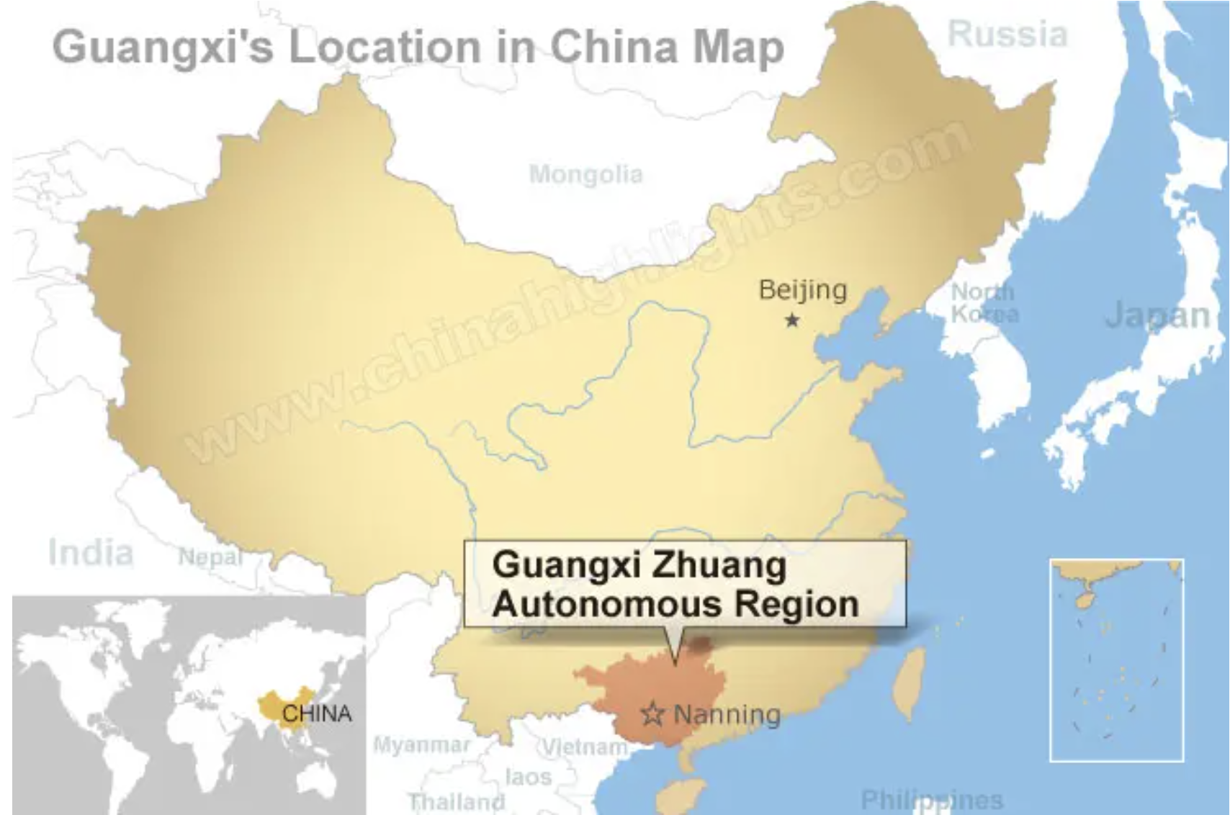
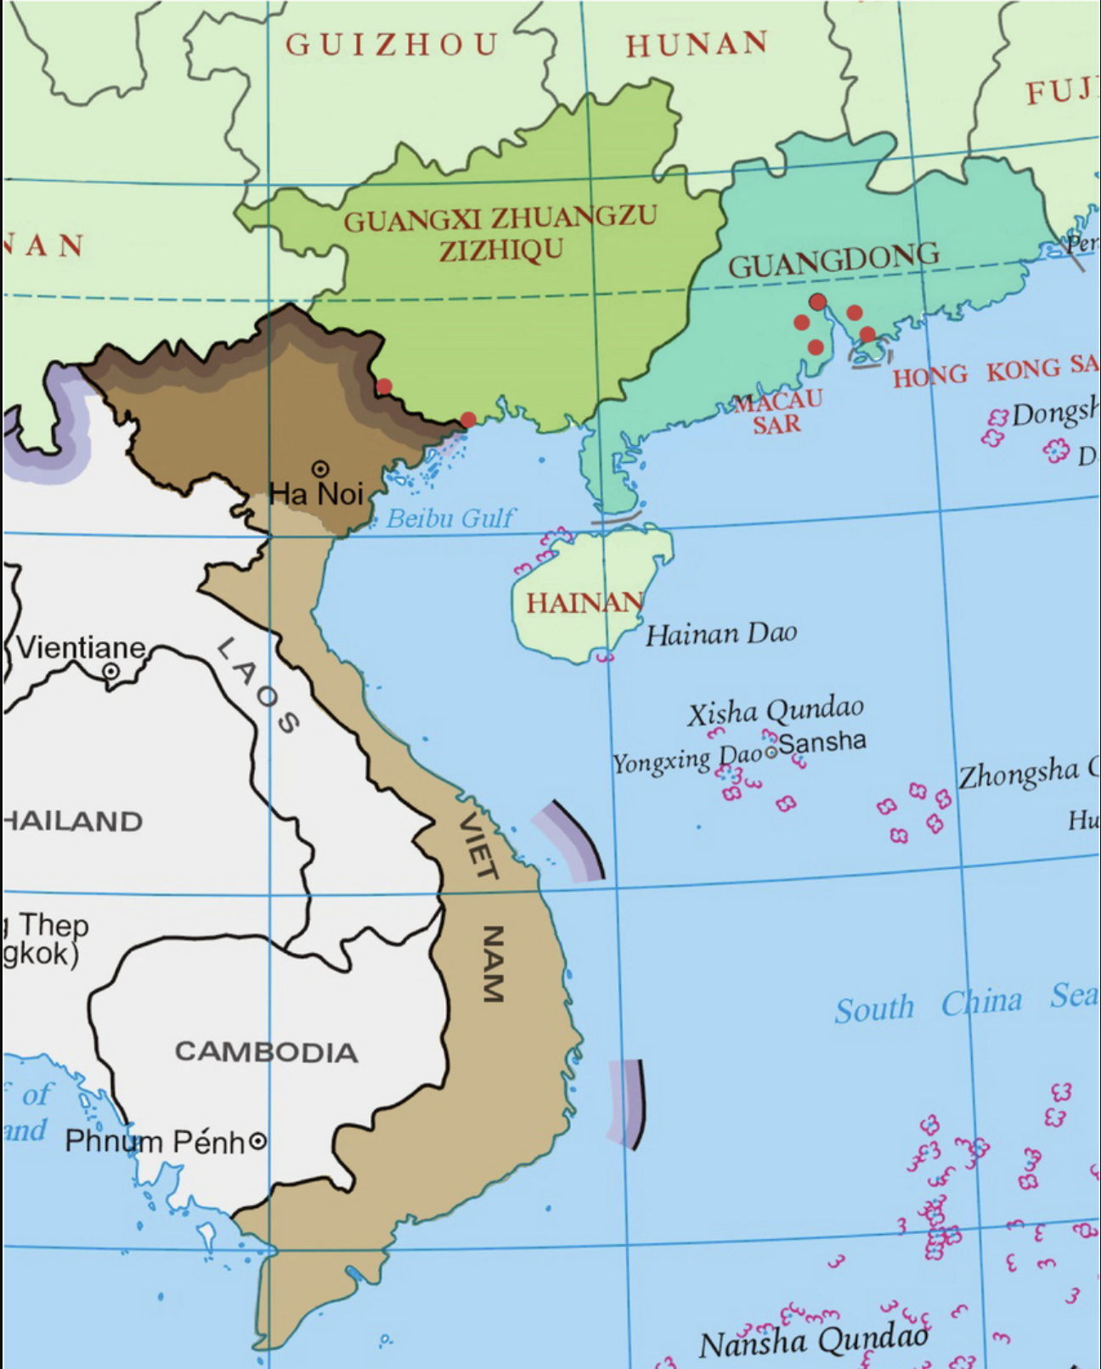
Background
Related Research Areas
  Cross-cultural interactions between Han Chinese and Zhuang minorities.
  The evolution and standardization of Chinese characters.
  Preservation of cultural identity through local adaptations of script.
Significance of the Study
  To Academia: Provides insight into how minority cultures preserve and adapt language amidst external influences.
  To Readers: Demonstrates the enduring impact of cultural adaptation on the preservation of diversity.
  To Society: Promotes appreciation for cultural heritage and minority contributions to national identity.

Slide 4
Literature Review
Previous Research
  Cultural Dynamics: Studies on the "Tianxia System" (Zhao Tingyang) emphasize the interaction between central and peripheral cultures.
  Character Standardization: Research on Chinese characters' evolution highlights standardization trends driven by central authorities (e.g., Kangxi Dictionary).
  Ethnic Minority Studies: Some focus on the cultural practices of Zhuang lack depth in analyzing variant characters.
Research Gaps
  Insufficient exploration of the cultural mechanisms enabling adaptation and transmission to broader cultural circles.
  Limited attention to how and why variant characters were preserved in minority regions.

Slide 5
Literature Review
Original Contribution
  New Perspective: Examines variant characters as tools for cultural resilience and cross-cultural transmission.
  Methodology: Combines textual analysis with cross-cultural frameworks to explore the interplay between identity, language, and geography.
  Focus: Highlights the Zhuang region's role as a bridge in spreading Chinese cultural elements to Southeast Asia.
Refocused Research Question
  How do variant characters reflect the cultural rhythms of Zhuang society, and what insights do they provide into the broader dynamics of cultural transmission?

Slide 6
Research Design/Method
Resources
  Historical Texts:
    Hand-copied manuscripts from the mid-to-late Qing Dynasty (e.g., Lingbao Shengdu Mifa Daquan 灵宝升度秘法大全).
    Ancient Zhuang script documents collected and curated by the Guangxi Minority Ancient Books Work Office.
  Standard References:
    Kangxi Dictionary, Han Dian(compiled by national authorities).
    Specialized dictionaries and databases: Variant Chinese Characters Dictionary, Zi Tong Net, Ancient Zhuang Character Dictionary.
  Books(example):
    Zhuang Shigong Daogong Scriptures(壮族师公道公经书)
    Identification of Ancient Book Editions.

Slide 7
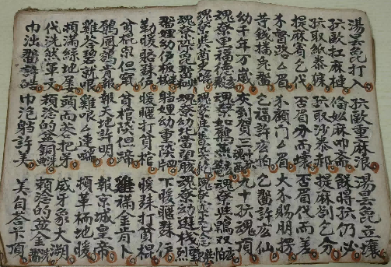
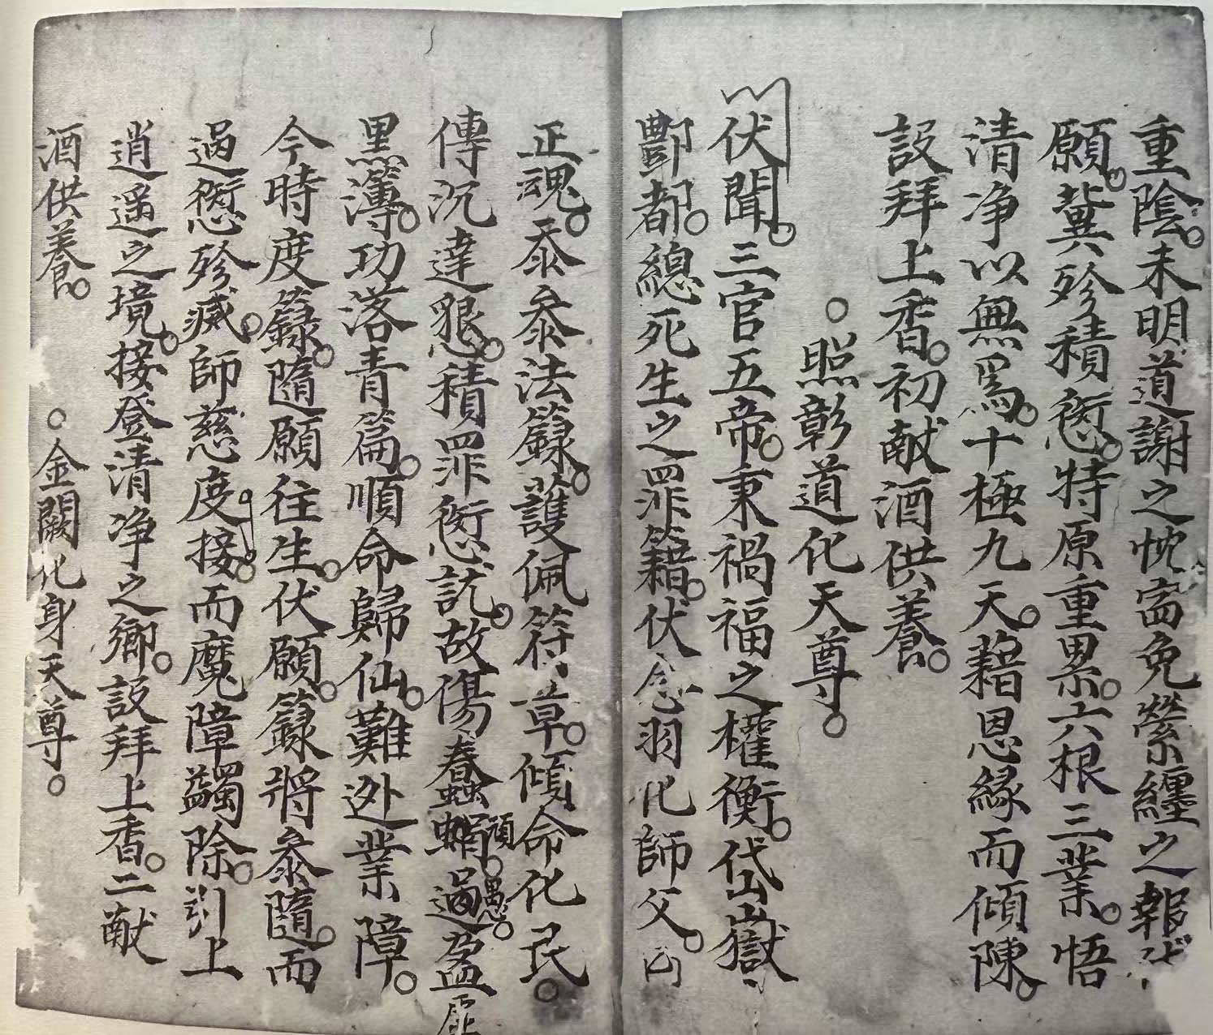
Research Design/Method
Data Collection
  Sampling Strategy:
    Focused on Zhuang region texts from the mid to late Qing Dynasty.
    Selected manuscripts with notable variant character usage.
  Approach:
    Analyzed hand-copied texts from local contexts.
    Cross-referenced with variant and standardized Chinese scripts (e.g., Kangxi Dictionary).

Slide 8
Research Design/Method
  Research Workflow
    Character Identification → Archival Analysis → Textual Comparison → Contextual Interpretation → Cross-Cultural Analysis(only for Vietnamese Chu Nom) → Conclusion Derivation.
    Preservation → localization/adaptation → cross-cultural expansion.

Slide 9
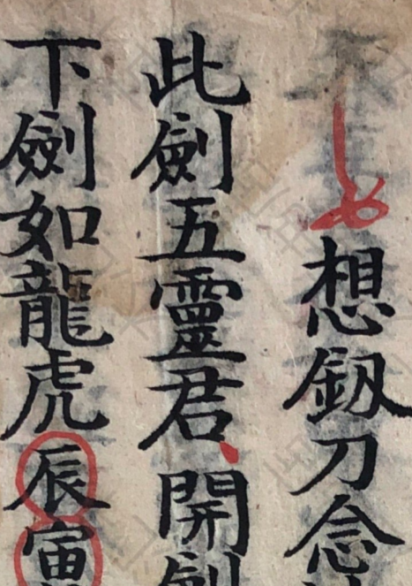
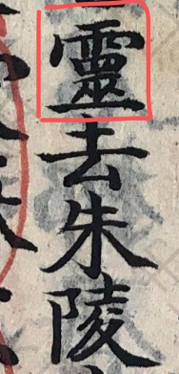



Research Design/Method
  Research Workflow
    Character Identification → Archival Analysis
1
Variant Standarded

Slide 10
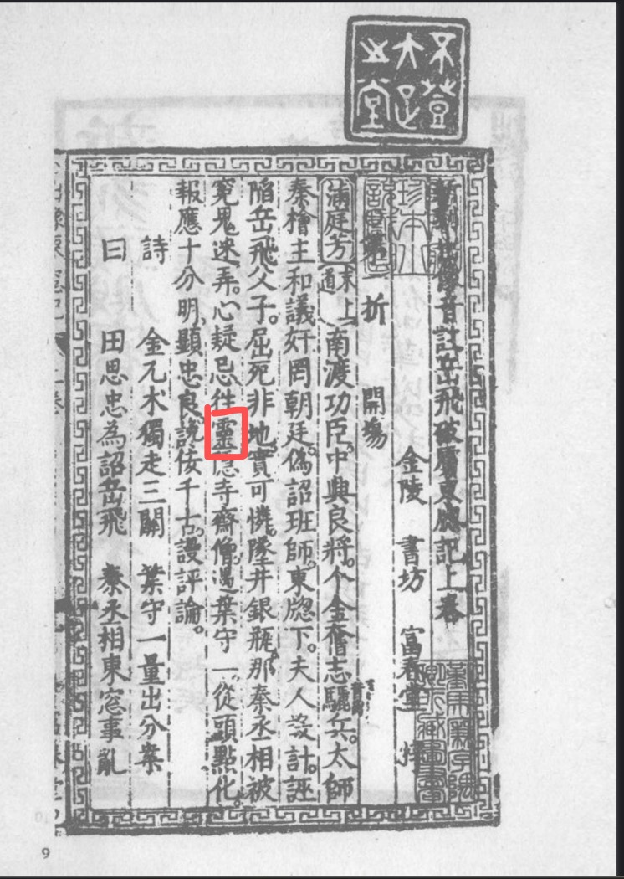
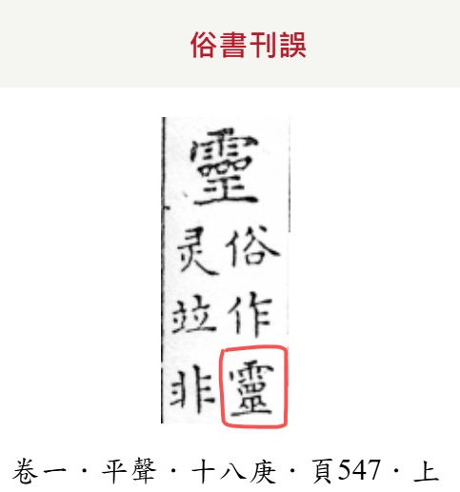


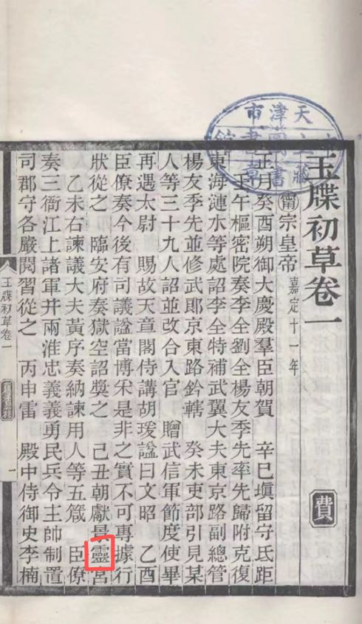
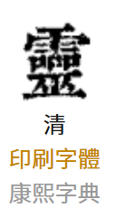
Research Design/Method
  Research Workflow
    Character Identification → Archival Analysis → Textual Comparison → Contextual Interpretation
1
Ming Dynasty
Qing Dynasty
Variant Standarded

Slide 11

Research Design/Method
  Research Workflow
    Character Identification → Archival Analysis → Textual Comparison → Contextual Interpretation → Conclusion Derivation.
1
Han Area
Ming Dynasty
Han Area
Qing Dynasty
Conclusion:
Different cultural rhythms: Zhuang area has different character using, compare to Han area in the same era; Zhuang area embodies slower change speed in writing system
Zhuang people keep the original meaning from Han writing system
Zhuang Area
Qing Dynasty

Slide 12
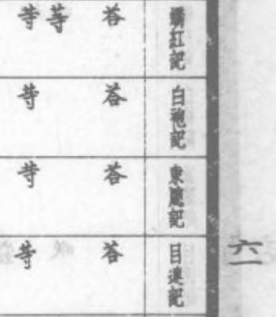
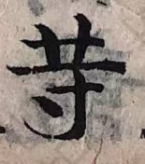
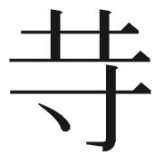

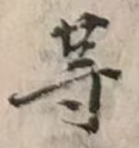
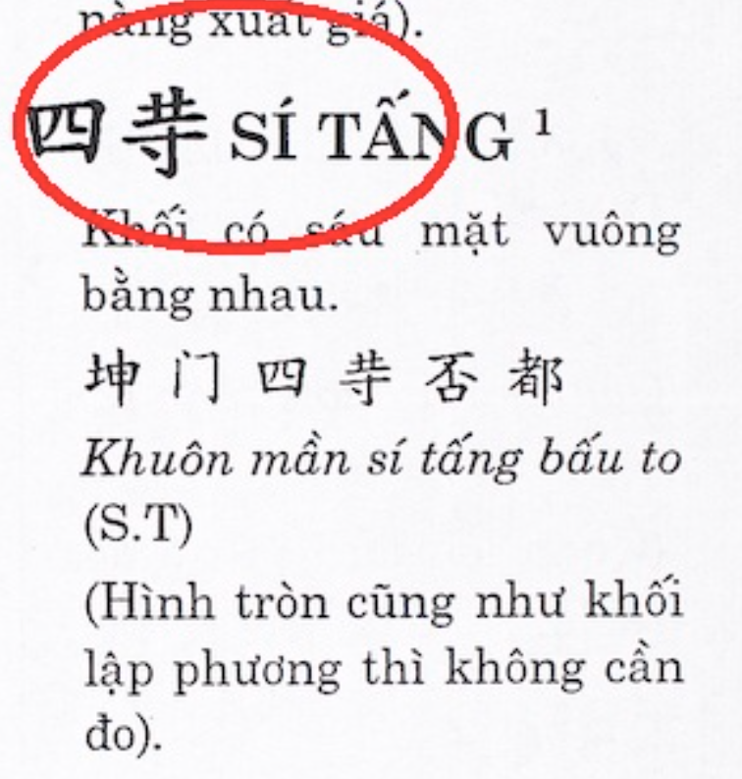
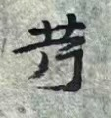
Research Design/Method
  Research Workflow
    Character Identification → Archival Analysis → Textual Comparison → Contextual Interpretation → Cross-Cultural Analysis(only for Vietnamese Chu Nom) → Conclusion Derivation.
2
Conclusion:
In the earlier discussions, the preservation and localization of Chinese variant characters in minority regions were analyzed,
Zhuang people spread the variant character to Southeastern Asia, especially influenced Vietnamese Chu Nom
Ming Dynasty
Chinese
Chu Nom
(喃字)
Variant Standarded

Slide 13
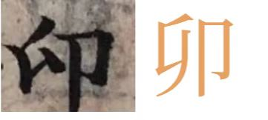
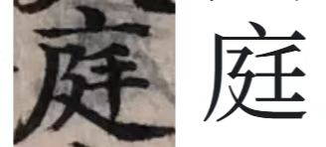
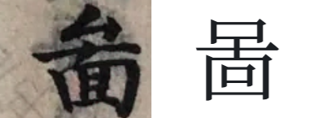
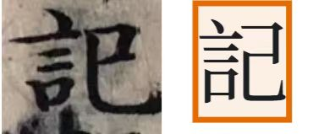
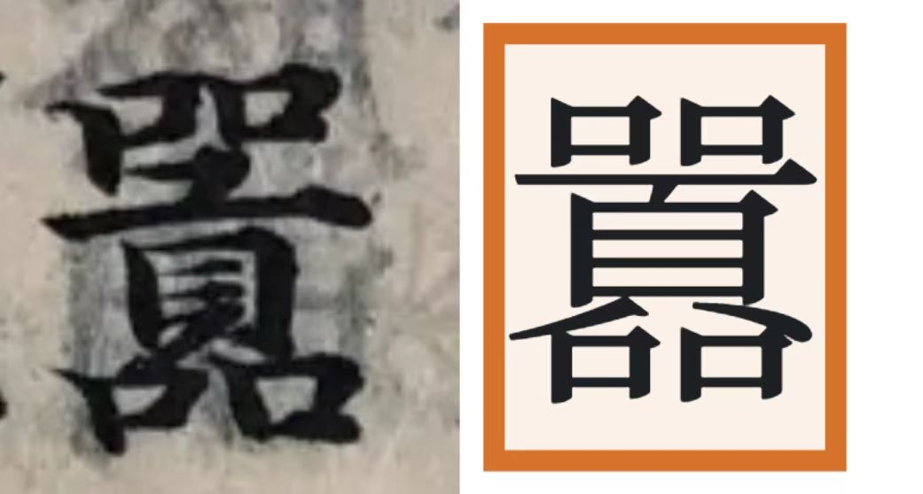
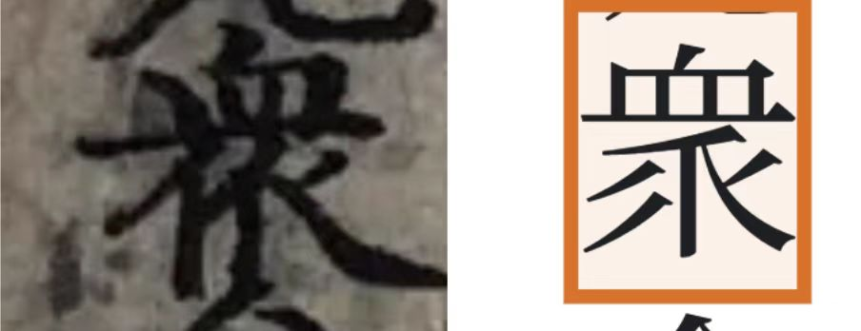
Results
Key Findings: more and more……

Slide 14
Results
Key Findings
    Cultural Rhythms in the Preservation of Variant Characters:
      Variant Chinese characters, which were standardized or eliminated in central Han regions, were retained in the Zhuang minority areas.
      This retention reflects a slower cultural rhythm in peripheral regions compared to the fast-paced standardization driven by political and cultural centralization in Han regions.
  Integration of Local and Central Cultures:
      The Zhuang region's unique geographical and cultural position allowed for a blending of Han cultural influences with local traditions.

Slide 15
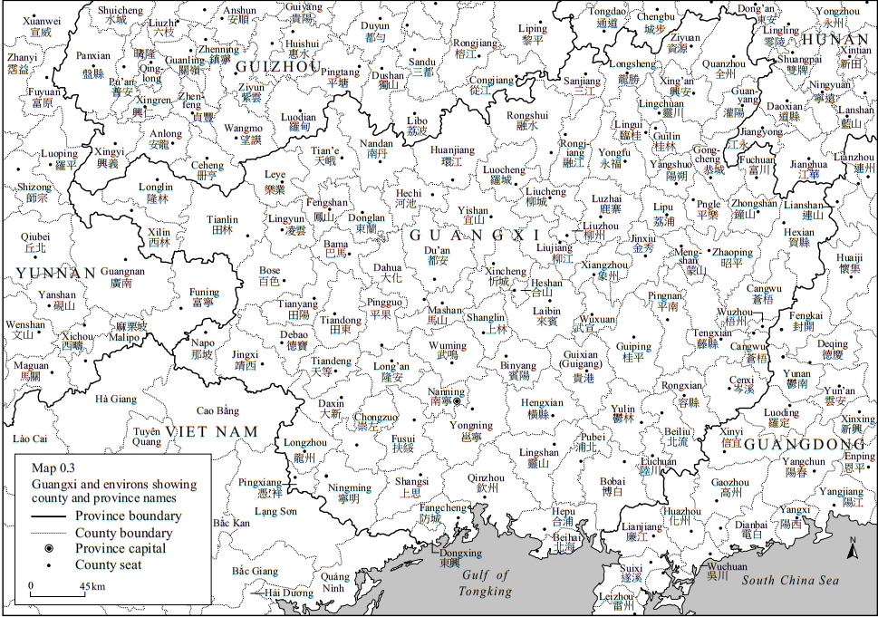
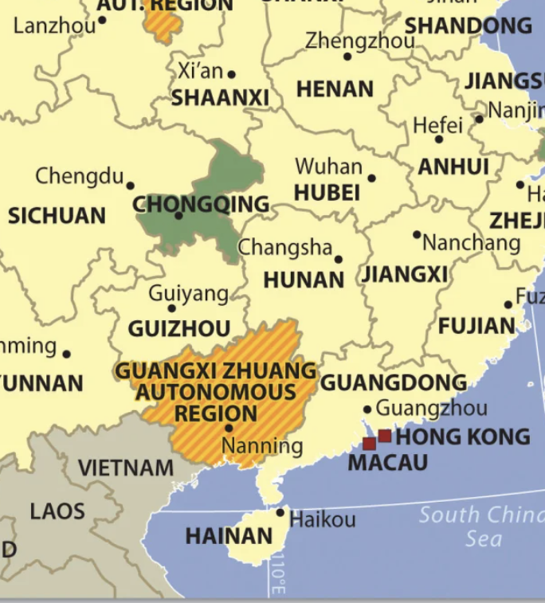
Results
Key Findings
    Cross-Cultural Dynamics:
      The Zhuang region acted as a bridge, transmitting cultural and linguistic elements to surrounding areas, including Southeast Asia, demonstrating the outward ripple of cultural influence.
Han Area → Guangxi Zhuang region → Southeast Asia(Vietnam, in particular)

Slide 16
Discussion
Comparison with Previous Research
  Extended Perspectives:
    Previous studies often focused on the standardization of Chinese characters (e.g., Kangxi Dictionary) or the role of minority regions in preserving older forms.
    This research highlights not only the preservation but also the adaptive reuse and innovative reinterpretation of variant characters in the Zhuang region, offering a more dynamic view of cultural rhythms.
  New Insights into Cross-Cultural Interaction:
    Earlier research primarily viewed minority regions as passive recipients of Han cultural diffusion. This study identifies the Zhuang region as an active participant and even a cultural bridge, transmitting linguistic elements to Southeast Asia (e.g., influence on Vietnamese Nom script).

Slide 17
Conclusion
Answering the Research Question
  This study demonstrates that cultural rhythms in the Zhuang region shaped the preservation, adaptation, and transmission of variant Chinese characters.
Limitations of the Study
  Focused primarily on the Zhuang region; further comparative studies with other minority areas (e.g., Miao or Dong regions) could provide broader insights.
  At present, there is a lack of systematic linguistic and historical research on the use of some variant characters and their semantic changes, resulting in an incomplete understanding of the transmission process and localization adaptation of these characters.
Future Research Directions
  Expanding the Scope:
    Investigate other minority groups in Southwest China to explore whether similar cultural rhythms exist in their textual traditions.
  Interdisciplinary Approaches:
    Incorporate digital humanities techniques, such as computational textual analysis, to uncover broader patterns in the evolution of variant characters.

Slide 18
References
[1]Zhao, T. Y. (2016). Hui Ci Zhongguo: China as a Sacred Concept (p. 18). Citic Press Group.
[2]Tan, Q. X. (Ed.). (1982). Historical Atlas of China. China Cartographic Publishing House.
[3]Same as [2], p. 15.
[4]Ge, Z. G. (2011). Zhai Zi Zhongguo: Reconstructing Historical Narratives about "China" (p. 35). Zhonghua Book Company.
[5]Kong, A. (Annotation), & Lu, D. (Glossary). (Song Dynasty Block-Printed Edition). The Book of Documents (Shangshu). Jing Wucheng Liu's Jia Yetang Collection (Sibu Congkan Edition).
[6]Wu, F. (2014). The Five Zones Map and the Kinship System in Ancient China. Social Sciences in China, 2014(02).
[7]Zhang, Y. S., & Chen, T. J. et al. (Eds.). (1716). Kangxi Dictionary. Qing Dynasty Block-Printed Edition.
[8]Gou, J. S. (Collector). (Daoguang Period, Qing Dynasty). Song Shengmu Xiao'er Shu (Manuscript). Privately held, Chaoyang District, Beijing.
[9]Gou, J. S. (Collector). (Late Qing Dynasty). Lingbao Shengdu Mifa Daquan (Manuscript). Privately held, Chaoyang District, Beijing.
[10]Fuchuntang (Publisher). (Circa Jiajing–Wanli [1522–1620]). Yue Fei's Defeat of the Invaders and the Eastern Window Record. Jinling.

Slide 19
References
[11]Fuchuntang (Publisher). (Circa Jiajing–Wanli [1522–1620]). Xue Rengui’s Expedition to the East and the White Robe Chronicle. Jinling.
[12]Miao, Q. S. (Compiler). (Guangxu–Xuantong Period, Qing Dynasty). Yu Die Chu Cao Juan Yi. In Ouxiang Ling Shi (Guangxu to Xuantong Period, Qing Dynasty Block-Printed Edition). Tianjin Municipal Library Collection.
[13]Jinling Carving Scripture Office (Publisher). (Guangxu 16 [1890]). Buddha’s Forty-Two Chapters Sutra with Commentary. Capital Library Collection.
[14]Gou, J. S. (Collector). (Late Qing Dynasty). Ji Jiu Ke (Manuscript). Privately held, Chaoyang District, Beijing.
[15]Institute of History and Philology, Academia Sinica. (1930). Dictionary of Vulgar Characters from the Song and Yuan Dynasties. Zhonghua Book Company.
[16]Jiao, H. (Wanli Period, Ming Dynasty). Corrections on Vulgar Characters. Ming Dynasty Block-Printed Edition.
[17]Jin, H., et al. (Supervising Editors). (Qing Dynasty). Guangxi Gazetteer. Qing Dynasty Editorial Edition.
[18]Yang, X. Y., Liang, J. H., & Zhao, C. X. (1997). History of Guangxi Education. Guangxi Normal University Press.

Slide 20
References
[19]Lan, W., & Huang, D. C. (2019). The Historical Periodization, Characteristics, and Multi-dimensional Causes of Guangxi Academies in the Ming Dynasty. Heilongjiang Social Sciences, 2019(2), 136–143.
[20]Gou, J. S. (Collector). (Guangxu Period, Qing Dynasty). Qiu Lu Lang (Manuscript). Privately held, Chaoyang District, Beijing.
[21]Hoàng, T. Â. (2003). Tự điển chữ Nôm Tày. Hà Nội: Nxb Khoa học Xã hội.
[22]Nguyễn, Q. H. (2014). Tự Điển Chữ Nôm Dẫn Giải. Hà Nội: Nhà Xuất Bản Giáo Dục Việt Nam.
[23]Nguyễn, D. (1820). Truyện Kiều (金云翘传).
[24]Anonymous. (Early 19th century). Phan Trần (潘陈传).

Slide 21
Thank you for all criticism and guidance.
Thank you for your constructive feedback!
Student Name：__Boge Xiao__ Research Advisor：_Dr. Zhang Zhehang_

