Slide 1


3RD INTERNATIONAL SYMPOSIUM ON GLOBAL SOUTH STUDIES
Emotional Worlds in
Zhuang Border Manuscripts
Boge Xiao | University of Washington
Visit https://globalsouthcollective.vn for full details
Contact email theglobalsouthcollective@gmail.com
Notes:
Good afternoon. My paper is titled Emotional Worlds in Zhuang Border Manuscripts. I look at handwritten ritual and teaching books that cannot be explained through only one national or linguistic frame. My focus today is simple: how do these manuscripts make belonging, memory, and authority visible?
[Sources]
- Abstract 332, accepted GSS 2026 paper abstract.
- GSS 2026 official theme and presentation template: https://globalsouthcollective.vn/call-for-abstract-submissions/

Slide 2
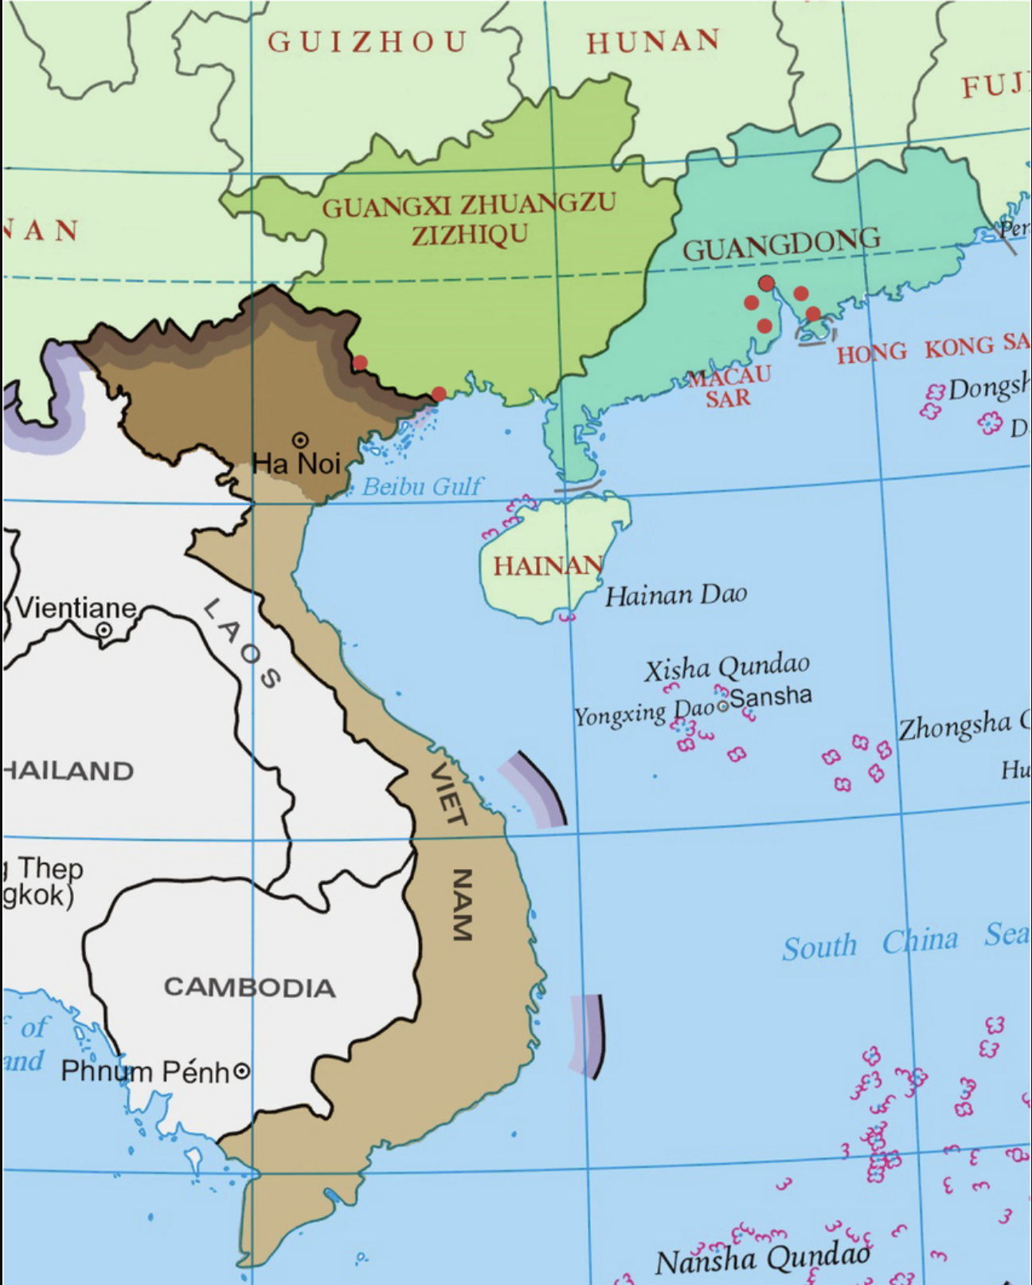
3RD INTERNATIONAL SYMPOSIUM ON GLOBAL SOUTH STUDIES
Border manuscripts make relations legible
Question
How do multiscript Zhuang manuscripts organize belonging when one national, linguistic, or historical frame is insufficient?
Emotionality names socially organized attachment.
Cultural rhythm explains selective renewal through copying, recitation, keeping, and annotation.
Emotional Worlds in Zhuang Border Manuscripts
2
Notes:
I am not asking whether these books are simply Chinese or Vietnamese. I am asking how they connect several textual and historical worlds. My argument has two parts. First, emotionality is a public relationship, not only a private feeling. Second, cultural rhythm describes how those relationships are kept, changed, and activated again through copying, ritual use, storage, and later annotation.
[Sources]
- Abstract 332.
- Monique Scheer, ‘Are Emotions a Kind of Practice?’ History and Theory 51(2), 2012.

Slide 3
3RD INTERNATIONAL SYMPOSIUM ON GLOBAL SOUTH STUDIES
Two scales: archive and working catalogue
Scale | Accepted abstract | Current status
Background archive | 139 manuscripts | unchanged
Explicit Vietnam-linked subset | 40 texts | unchanged
Working layer | First pass | Second pass | Current total
Catalogue records | 43 | +34 | 77
Explicit / candidate markers | 43 | +9 | ≥52
Catalogue records ≠ physical codices. The Guangxi baseline remains incomplete, so the update adds resolution—not a new closed denominator.
Emotional Worlds in Zhuang Border Manuscripts
3
Notes:
The accepted abstract was based on 139 Zhuang manuscripts, including 40 texts explicitly linked to Vietnam. I keep those figures unchanged. Since then, I have completed a detailed working catalogue of 77 records. These 77 records are not necessarily 77 separate books, and the Guangxi material is still incomplete. So this catalogue gives me better detail, but it is not yet a closed statistical sample.
[Sources]
- Abstract 332: 139 manuscripts; 40 explicitly linked to Vietnam.
- Boge Xiao, Google Drive working document 《壮族喃字整理》, 77 catalogue records, revision read 20 Aug. 2026.

Slide 4
3RD INTERNATIONAL SYMPOSIUM ON GLOBAL SOUTH STUDIES
Emotionality organizes attachment as relation
Relation | Textual device | Emotional work
Living ↔ dead | invocation · offering | loss becomes actionable
Descendants ↔ ancestors | lineage geography | remembered authority
Relation | Device | Practice | Limit
Readers ↔ languages | later glosses | re-pronounce | not origin
Practitioners ↔ books | repertoire | select + copy | not private intent
The claim concerns public, repeatable relations—not recovered private feeling.
Emotional Worlds in Zhuang Border Manuscripts
4
Notes:
Here, emotionality means a relationship that a text makes public and repeatable. A ritual book may connect the living with the dead, descendants with ancestors, or a later reader with an older manuscript. Recitation, offerings, copying, and glossing make these relationships actionable. I am therefore not trying to recover a copyist private feelings. I am asking what kinds of attachment the text authorizes.
[Sources]
- Abstract 332.
- GSS 2026 theme: emotionality as relational and socially mediated.
- Scheer 2012.

Slide 5
3RD INTERNATIONAL SYMPOSIUM ON GLOBAL SOUTH STUDIES
Cultural rhythm is selective renewal through practice
Five
operations
Repertoire maintenance · functional books remain available
Active persistence · stable frame, repeated use
Functional differentiation · scripts and genres do different work
Re-anchoring · dates, places, ancestral geographies
Reactivation · later notes restore use
Practice-coupled differential synchronization
Emotional Worlds in Zhuang Border Manuscripts
5
Notes:
Cultural rhythm is not just a metaphor for change. In plain language, it means that different layers of a manuscript can change at different speeds while remaining connected through practice. An old place formula may remain beside a later copying date and an even later Vietnamese note. I study five operations: maintenance, persistence, differentiation, re-anchoring, and reactivation. These operations give the concept something we can actually observe and test.
[Sources]
- Boge Xiao, revised cultural-rhythm formulation from the 77-record catalogue.
- Henri Lefebvre, Rhythmanalysis.
- Igor Kopytoff, ‘The Cultural Biography of Things.’

Slide 6
3RD INTERNATIONAL SYMPOSIUM ON GLOBAL SOUTH STUDIES
Four layers keep evidence and inference distinct
Four
layers
1 · Verbatim record · retain doubtful readings
2 · Normalized metadata · person/role · date · place · layer
3 · Textual function · what does the marker do here?
4 · Bounded interpretation · relation · mechanism · alternatives
If one link is missing, the conclusion must shrink.
Emotional Worlds in Zhuang Border Manuscripts
6
Notes:
To avoid overclaiming, I use four layers of evidence. I begin with the wording on the page. Then I identify the person, date, place, and writing layer. Next, I ask what the feature does in that passage. Only after that do I interpret it. This rule is important: if one link is missing, the claim must become smaller. A place name is not automatically a migration route, and a later note is not the original copying layer.
[Sources]
- Boge Xiao, 77-record research catalogue and verbatim Appendix A.
- Reviewer request to operationalize cultural rhythm and emotionality.

Slide 7
3RD INTERNATIONAL SYMPOSIUM ON GLOBAL SOUTH STUDIES
Recurrent practices in 77 catalogue records
WORKING SET
≥52
LINKED
GUANGXI BASELINE
INCOMPLETE
77
RECORDS
≥19 SECURE
YEARS
43 CORE
+34 NEW
43 DATE
FORMULAS
19 NOTES
20 NÔM
Emotional Worlds in Zhuang Border Manuscripts
7
Notes:
This slide shows the present shape of the catalogue. We have 43 date formulas, at least 19 relatively secure years, 19 Vietnamese annotation cases, and at least 20 Nôm cases. The categories overlap. The point is not to claim a final percentage. The point is to see which patterns recur across the collection and which claims still depend on one exceptional example.
[Sources]
- Counts computed from the 77-record working catalogue; categories overlap and the Guangxi baseline remains incomplete.

Slide 8
3RD INTERNATIONAL SYMPOSIUM ON GLOBAL SOUTH STUDIES
Dates and places mark horizons, not routes
Record | Internal formula | Current reading
01 | bingchen + old Tuyên Quang hierarchy | 1856 stronger only if same layer
65 | Guangxu 18 → xinchou | 1892 → 1901
Manuscript wording | Conditional reconstruction | Function | Limit
Đại Nam → Tuyên Quang → Tương An → Để Định | older hierarchy | historical anchoring | not a route
Great France · Hà Giang · Bảo Lạc | colonial place-world | re-anchoring | not provenance
Historically responsible geography keeps two columns: manuscript wording + conditional reconstruction.
Emotional Worlds in Zhuang Border Manuscripts
8
Notes:
Dates and places show several historical horizons, but they do not draw a travel route by themselves. One manuscript combines a cyclical date, an older Đại Nam and Tuyên Quang address, and a Guangxi place name. If those details were written at the same time, 1856 is a stronger date than 1916. But if the address was copied from an older model, that conclusion becomes weaker. So I keep two columns: the manuscript’s exact wording and my conditional historical reconstruction.
[Sources]
- Vietnam National Archives Center I: Nguyễn and French-period administrative hierarchies; Tuyên Quang historical administration.
- Boge Xiao, records 1, 20–21, 25, 43, 65, 73.

Slide 9
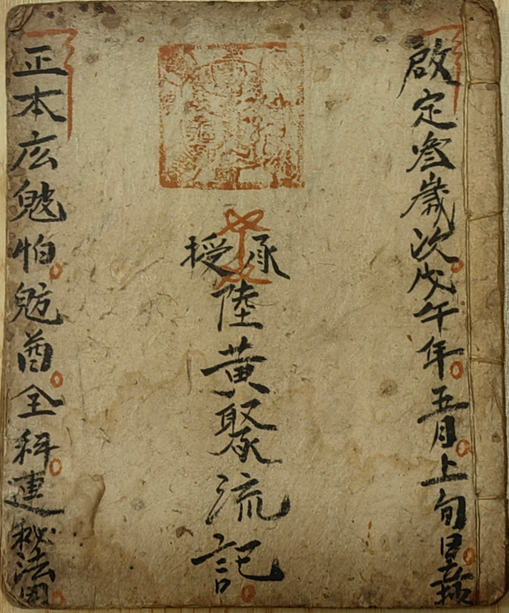
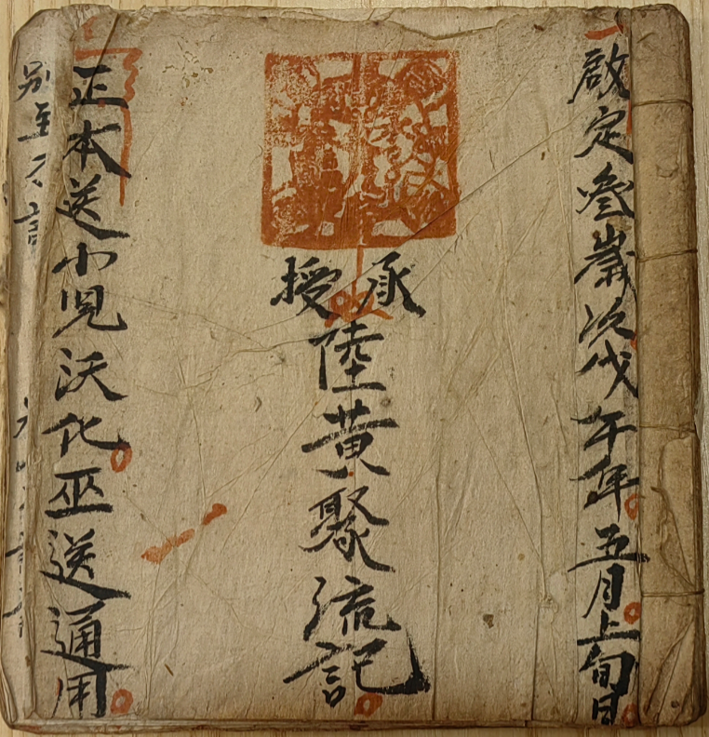
3RD INTERNATIONAL SYMPOSIUM ON GLOBAL SOUTH STUDIES
Same copyist, same date, different ritual books
Copyist · Lu Huangju (陆黄聚)
Date formula · 启定三岁次戊午年五月上旬日立抄 · 1918–Khải Định 3 yrs wuwu（戊午）
Confirmed pair · same copyist and time; different contents
Mechanism · repertoire maintenance + functional differentiation
Boundary · repertoire inference, not proof of direct copying between the books
CASE 1 · REPERTOIRE
Emotional Worlds in Zhuang Border Manuscripts
9
Notes:
A much firmer case comes from Lu Huangju. The colophon reads the third year of Khải Định, cyclical wuwu, in the first ten days of the fifth lunar month: 1918. The two books were copied by the same person at the same time, but their contents are different. This is no longer a hypothesis based only on a shared seal or custody. It lets me study a practitioner’s repertoire: different books kept available for different ritual tasks.
[Sources]
- Boge Xiao correction: records 10 and 11 were copied by Lu Huangju at the same time, Khải Định 3 / wuwu / early fifth lunar month / 1918, with different contents.
- Boge Xiao, records 10–11.

Slide 10
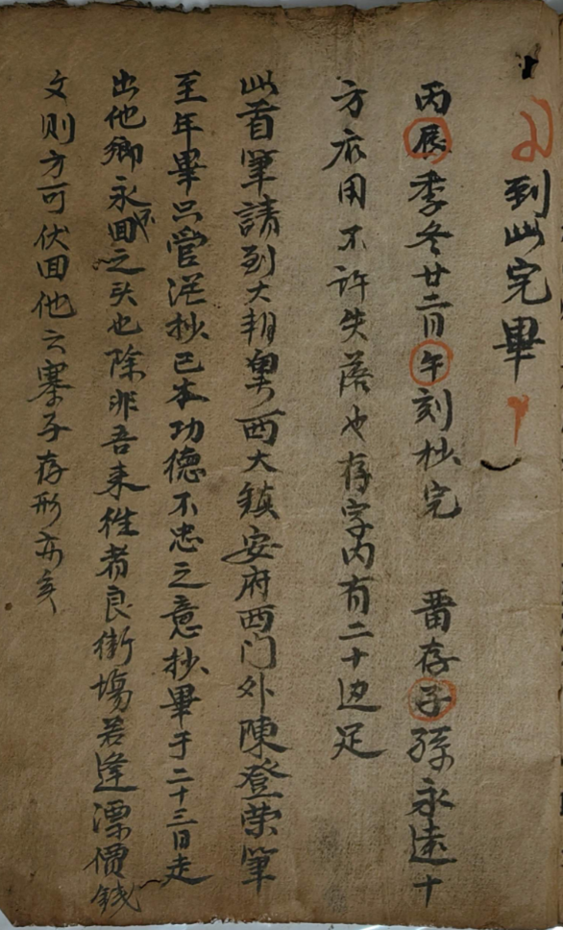
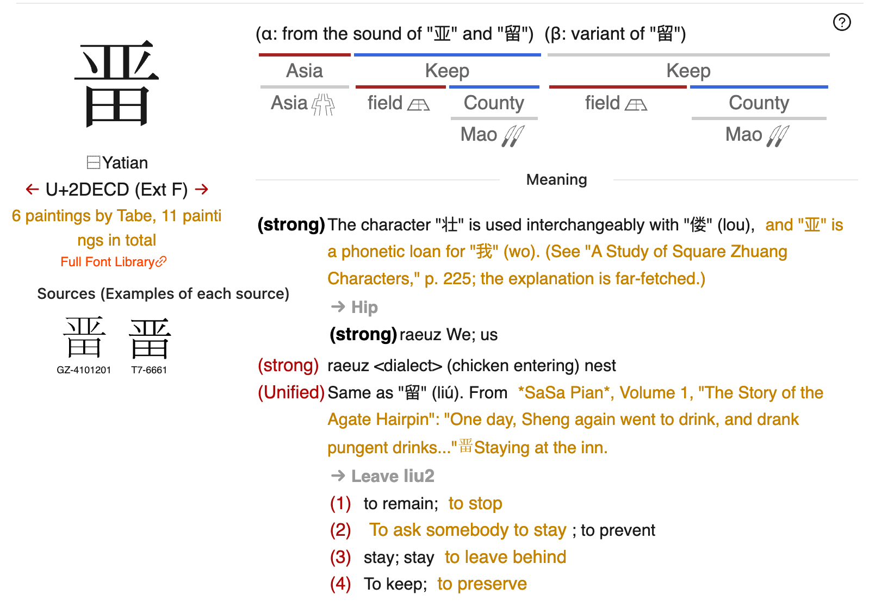
3RD INTERNATIONAL SYMPOSIUM ON GLOBAL SOUTH STUDIES
A graph becomes evidence through five tests
Unit · structure × reading/tone × meaning × textual position × distribution
Protocol · page/line → component analysis → dictionary candidates → context
Dictionaries · candidate-reading repositories, not final judges
Confidence · A: convergent + repeated · B: contextual · C: graphic only
Limit · shared sinographic resources ≠ shared etymology or direction
METHOD · FIVE-TEST PROTOCOL
Emotional Worlds in Zhuang Border Manuscripts
10
Notes:
For character comparison, an isolated visual resemblance is not enough. I compare five things: structure, reading and tone, meaning, position in the passage, and distribution across texts. Dictionaries provide possible readings, but the manuscript context must make the final decision. The same Chinese-character resource can work as a full loan, a sound element, or a meaning element. So shared form does not automatically prove shared origin or a direction of transmission.
[Sources]
- Qin Xiaohang, 方块壮字研究.
- 《古壮字字典》; Vũ Văn Kính, Đại Tự Điển Chữ Nôm; Trần Văn Kiệm, Giúp Đọc Nôm Và Hán Việt.

Slide 11
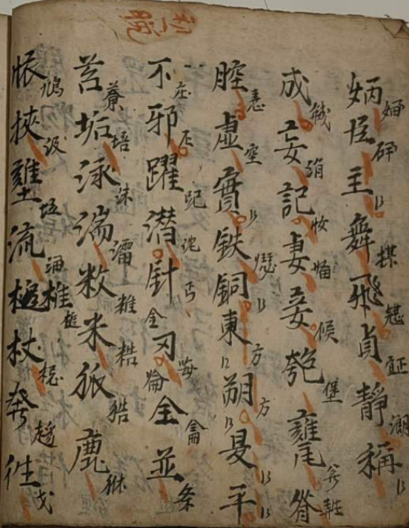
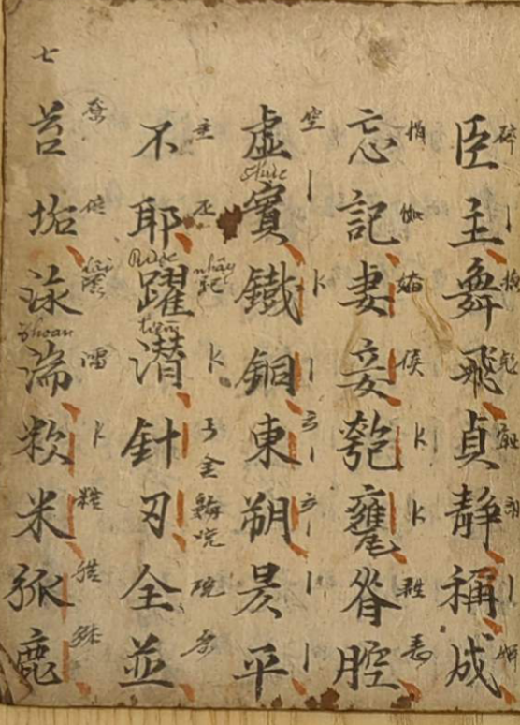
3RD INTERNATIONAL SYMPOSIUM ON GLOBAL SOUTH STUDIES
Matched texts make rhythm measurable
Pair · 《都三千一句》 (1906) + 《三千字解音》 (1917)-- Three Thousand Characters
Stable · content and lexical order
Variable · some Han–Nôm correspondences
Measures · structure-retention rate + local-replacement rate
Claim · a curriculum persists while reading technology changes
CASE 2 · TEXT PAIR
Emotional Worlds in Zhuang Border Manuscripts
11
Notes:
The clearest controlled comparison is between two Three Thousand texts dated 1906 and 1917. Their content and order are the same, but some Han–Nôm correspondences are different. This gives us two measurable questions: how much of the structure is retained, and where do local replacements occur? The teaching sequence stays stable while some reading solutions change. This is cultural rhythm in a form that can be counted, compared, and challenged by other researchers.
[Sources]
- Boge Xiao, records 37 and 42: 《都三千一句》 (1906) and 《三千字解音》 (1917).

Slide 12
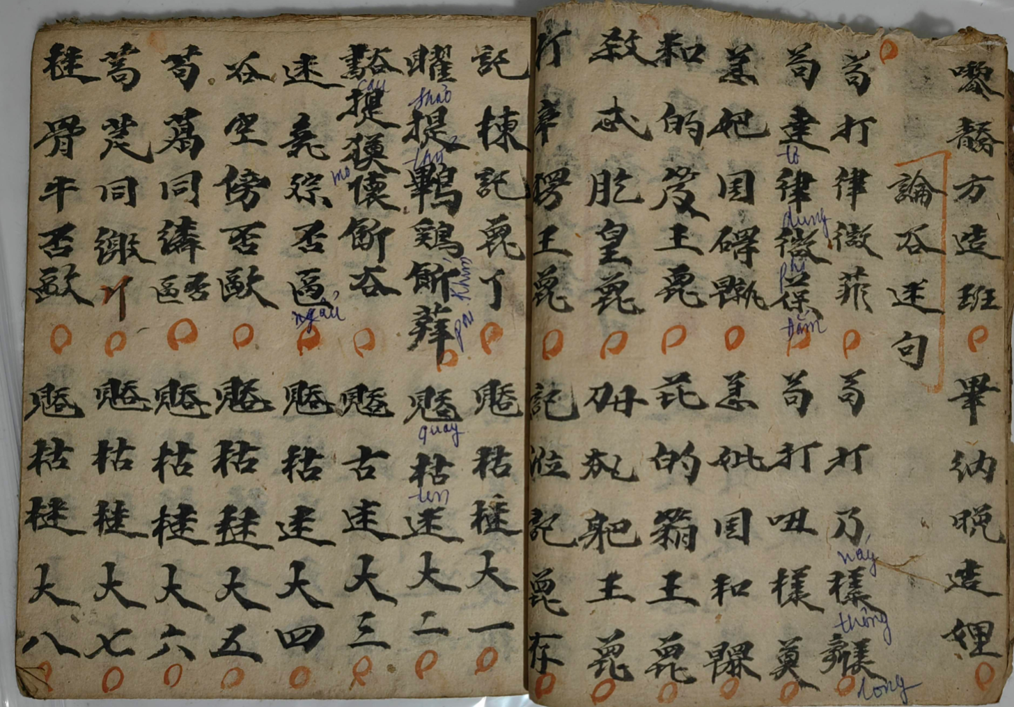
3RD INTERNATIONAL SYMPOSIUM ON GLOBAL SOUTH STUDIES
Vietnamese glosses reactivate an older text
Primary case · 《正一巫送见在科》
Main layer · Nôm + Sawndip in a Zhuang ritual chant
Later layer · blue Vietnamese spelling marks pronunciation
Operation · the inherited book becomes pronounceable again
Limit · later engagement ≠ original copying place
CASE 3 · REACTIVATION
Emotional Worlds in Zhuang Border Manuscripts
12
Notes:
Later Vietnamese notes are also important evidence. In several books, blue writing gives pronunciations for older Zhuang graphs. This shows reactivation: a later reader made an inherited text pronounceable again. But the limit is equally important. A Vietnamese gloss proves later engagement with the book. It does not prove that the original book was copied in Vietnam or that it followed a particular route.
[Sources]
- Boge Xiao, records 5 and 52: later Vietnamese and traditional-Chinese annotation layers.

Slide 13
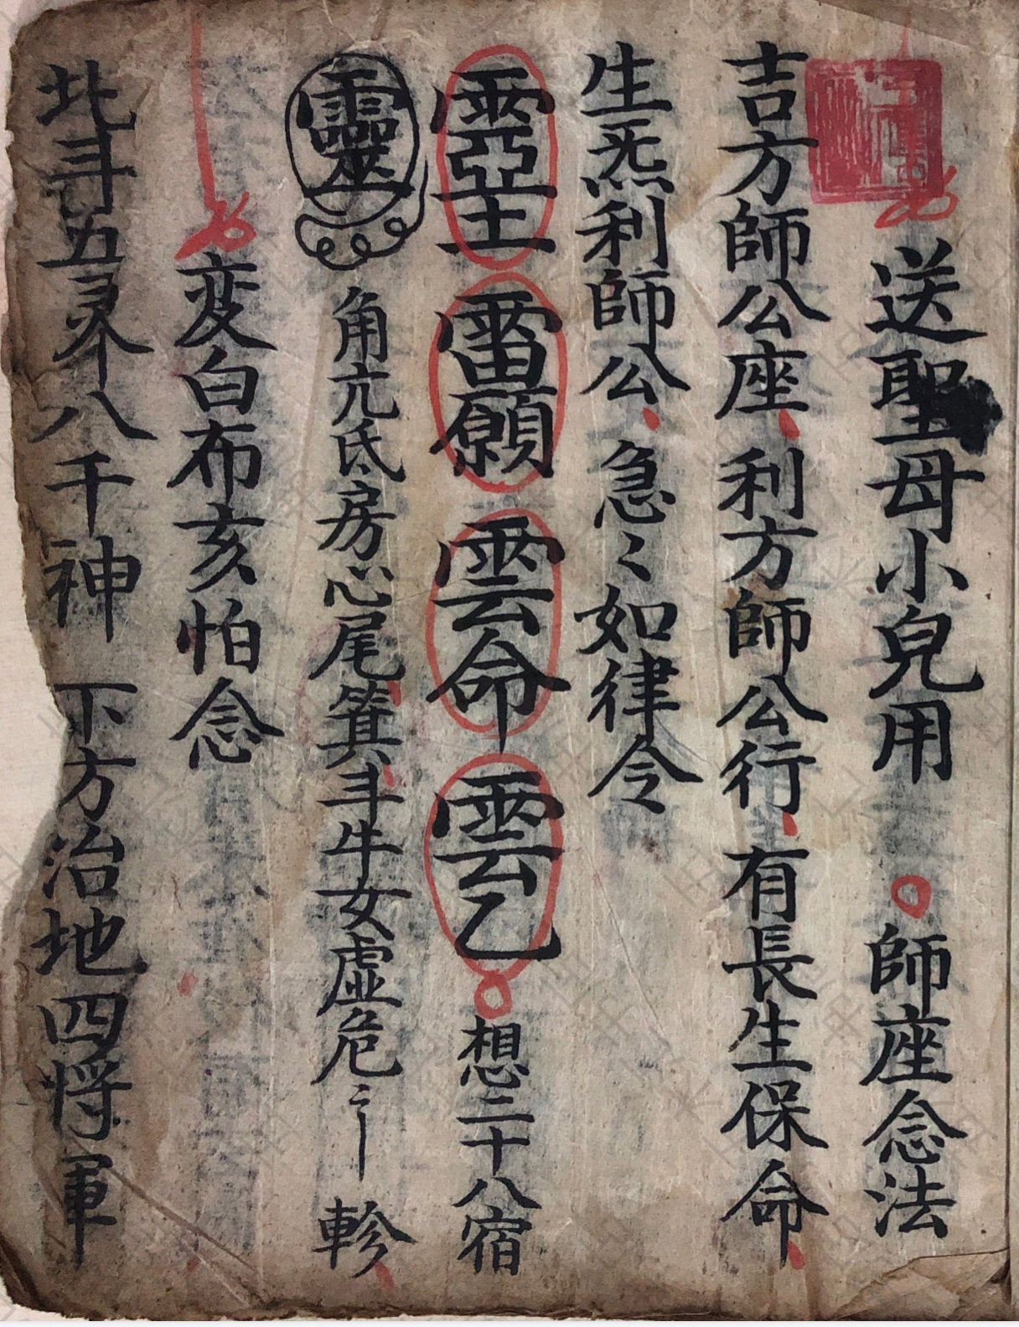
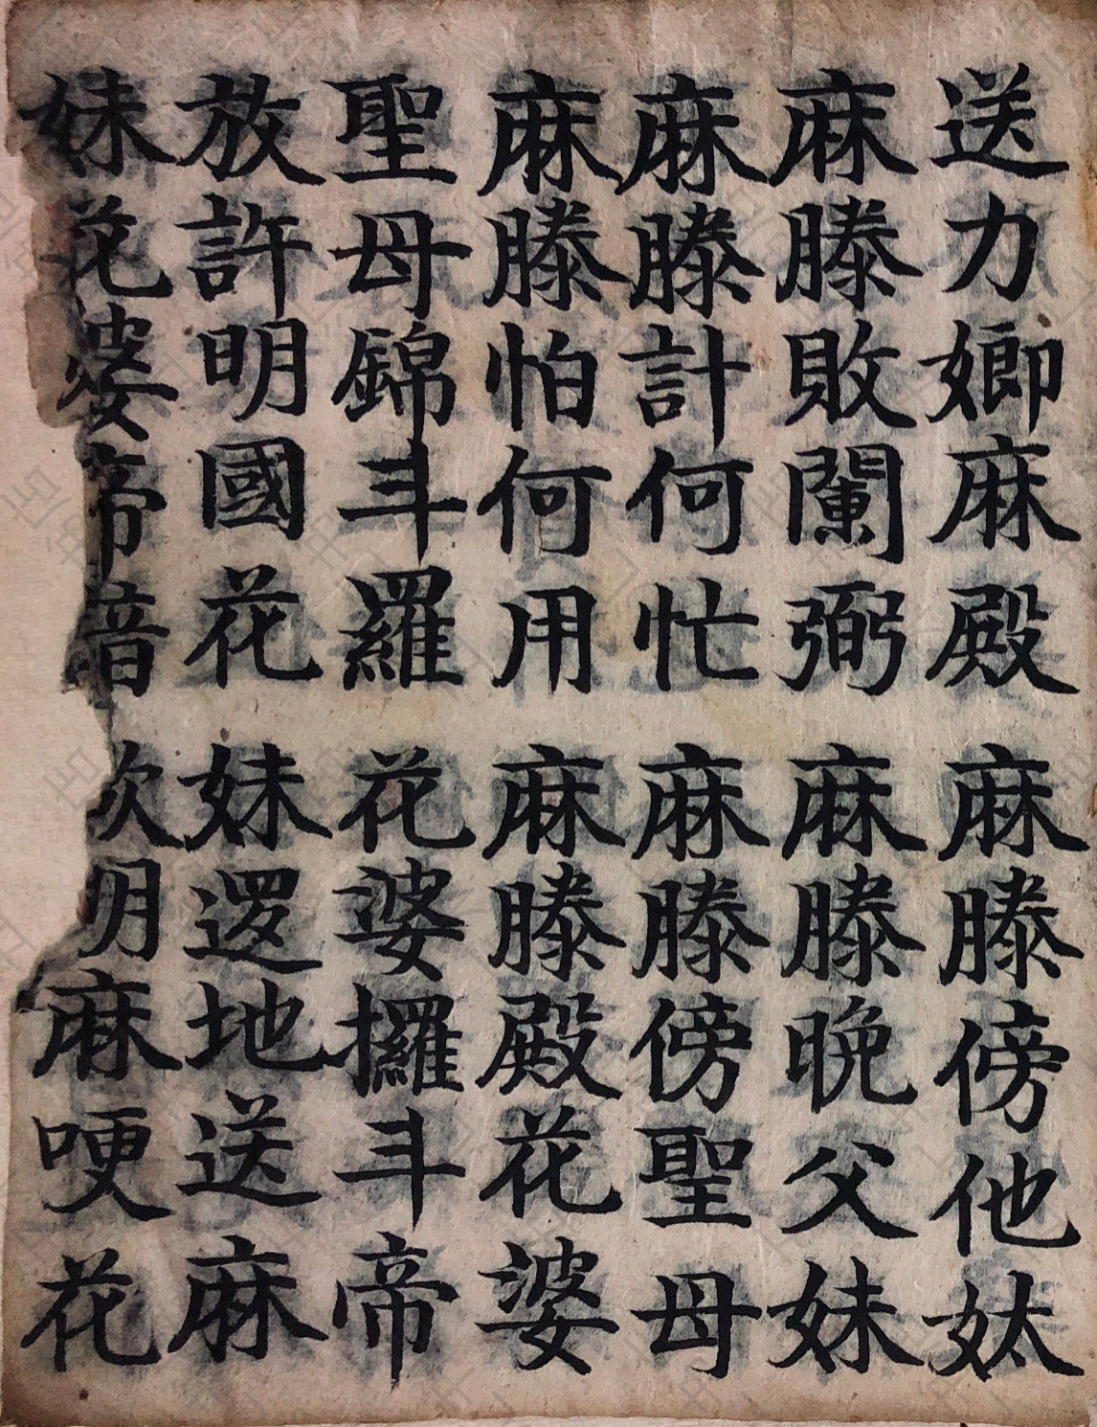
3RD INTERNATIONAL SYMPOSIUM ON GLOBAL SOUTH STUDIES
Ritual language makes loss addressable
Text · 《送圣母小儿用》
World · Holy Mother · Flower Goddess · child · hell-breaking
Sequence · the dead is refined; the child enters a celestial realm
Relation · child · family · ritual specialist · sacred world
Boundary · authorized care, not recovered private grief
CASE 4 · RITUAL CARE
Emotional Worlds in Zhuang Border Manuscripts
13
Notes:
The manuscript Song Shengmu Xiao’er Yong brings us closest to emotionality. Its ritual world includes the Holy Mother, the Flower Goddess, a child, the dead, and the transformation of the soul. The text does not simply describe grief. It gives the family and the ritual specialist a sequence of actions in response to loss. Emotionality here is organized care. I cannot claim that every participant felt the same emotion, but I can show how the manuscript made care and transformation ritually possible.
[Sources]
- Boge Xiao, record 48, 《送圣母小儿用》; user-supplied scan, especially the transformation sequence previously identified on p.16.

Slide 14
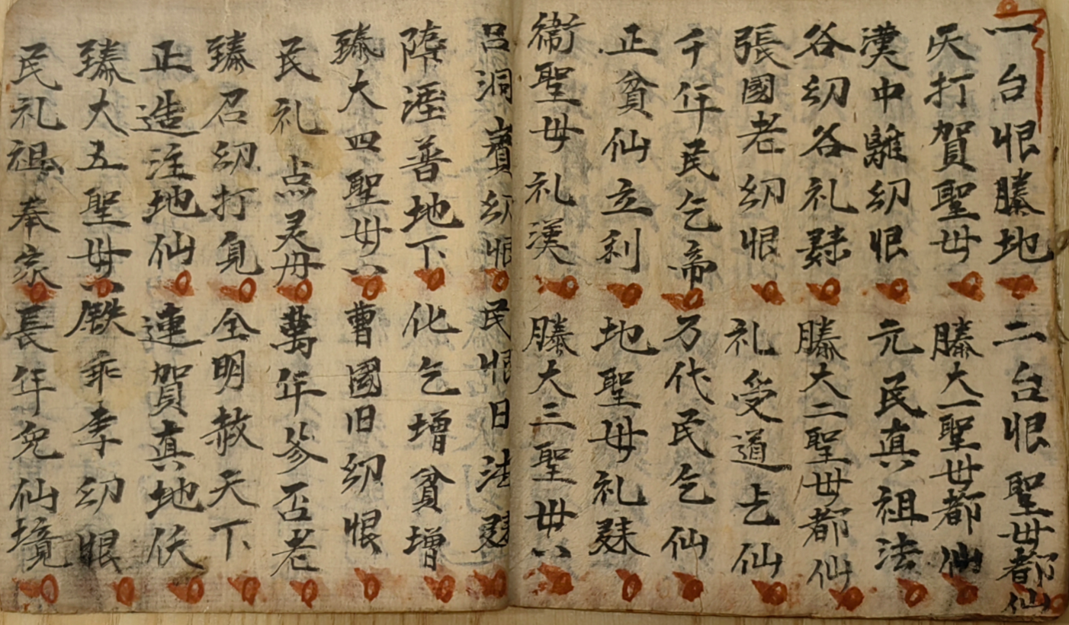
3RD INTERNATIONAL SYMPOSIUM ON GLOBAL SOUTH STUDIES
Familiar immortals enter a Holy Mother frame
Text/date · 《正本送小儿沃化巫送通用》 · Lu Huangju · 1918
Sequence · ‘八圣母都仙’ · 腾大一/二/三圣母都仙
Named figures · Han Zhongli · Zhang Guolao · Lü Dongbin …
Operation · mostly male Eight-Immortal names enter a repeated shengmu frame
Limit · re-framing ≠ demonstrated literal gender conversion
CASE 5 · RITUAL RE-FRAMING
Emotional Worlds in Zhuang Border Manuscripts
14
Notes:
This 1918 book by Lu Huangju contains many Sawndip forms and ritual sections that I cannot yet classify as entirely Daoist; some may belong to Zhuang Mo traditions. In a passage I provisionally identify as Eight Holy Mothers Become Immortals, repeated Holy Mother formulas stand beside Han Zhongli, Zhang Guolao, Lü Dongbin, and other Eight-Immortal names, often written non-standardly. The secure claim is not that these male figures literally became women. It is that a familiar pantheon was re-framed through Holy Mother language. The grammar and ritual function still need line-by-line study.
[Sources]
- Boge Xiao, verbatim transcription and correction for record 10, 《正本送小儿沃化巫送通用》, 1918.
- Names and unidentified graphs remain provisional pending line-by-line philological and ritual analysis.

Slide 15
3RD INTERNATIONAL SYMPOSIUM ON GLOBAL SOUTH STUDIES
Ancestral geographies authorize belonging
Current catalogue | Formula | Occurrences
77 records | Jiangxia | 5
77 records | Yanmen / Longxi | 1 / 1
Scope | Textual work | Emotional relation | Limit
Current 77 | surname + prestige geography | descendants · ancestors | not migration
Broader 139 | Hejian also in abstract | aspiration · authority | needs genealogy
A lineage formula can authorize belonging without proving biological origin or a Central Plains itinerary.
Emotional Worlds in Zhuang Border Manuscripts
15
Notes:
The manuscripts also connect surnames with ancestral places. In the current catalogue, Jiangxia appears five times, while Yanmen and Longxi each appear once. The wider archive also includes Hejian. These formulas may connect a local practitioner with ancestry, prestige, and a longer historical imagination. But they do not by themselves prove biological descent or a migration route from the Central Plains. My claim is narrower: ancestral geography authorizes belonging.
[Sources]
- Current 77-record catalogue: Jiangxia ×5, Yanmen ×1, Longxi ×1.
- Abstract 332 additionally names Hejian in the wider 139-manuscript archive.

Slide 16
3RD INTERNATIONAL SYMPOSIUM ON GLOBAL SOUTH STUDIES
Five mechanisms connect texts to belonging
Five
modes
Maintain · keep a functional repertoire available
Persist · repeat a frame through practice
Differentiate · assign scripts and genres distinct jobs
Re-anchor · cite reigns, places, and ancestors
Reactivate · annotate for a later reader
Micro-level philology becomes a theory of relational belonging.
Emotional Worlds in Zhuang Border Manuscripts
16
Notes:
Across these cases, five mechanisms recur. Books are maintained as a useful repertoire. Textual frames persist through repeated use. Different scripts and genres do different jobs. Dates, places, and ancestors re-anchor a text. Later notes reactivate it for a new reader. Together, these mechanisms connect small philological details with a larger question: how does a community keep relationships available across time?
[Sources]
- Cross-case synthesis from records 5, 10–11, 37, 42, 48, 52, 65, and 68.

Slide 17
3RD INTERNATIONAL SYMPOSIUM ON GLOBAL SOUTH STUDIES
Competing explanations make the model testable
Testable
model
ALTERNATIVES
Independent construction · same character resources
Common template · shared formula without direct copying
Later layer · address or gloss added after copying
Same surname · not necessarily the same person
SUPPORT + PREDICTION
Multi-variable cluster · sequence + hand + material layer + date + function
Prediction · a maintained repertoire clusters across more than one variable
Emotional Worlds in Zhuang Border Manuscripts
17
Notes:
This model must remain testable. Similar graphs may be created independently. Shared formulas may come from a common template rather than direct copying. A place name may belong to a later layer. A shared surname may refer to another person. The cultural-rhythm argument becomes stronger only when several kinds of evidence cluster together: sequence, handwriting, material layer, date, repeated formula, and ritual function. The unfinished Guangxi catalogue will provide an important comparison.
[Sources]
- Boge Xiao, evidence-tier and falsifiability model.
- Qin Xiaohang, structured graphic variation in Sawndip.

Slide 18

Global South manuscript studies begin
with connected knowledge worlds—
locally grounded, internationally testable.
Notes:
For Global South scholarship, these manuscripts are not incomplete copies of a national canon. They are knowledge worlds made by ordinary practitioners. My starting point remains Chinese and Zhuang scholarship on writing and local cultural categories. International theories of emotion, rhythm, and material life help me test the mechanism. They do not replace the concepts closest to the archive. This allows the research to remain locally grounded and internationally comparable.
[Sources]
- Abstract 332.
- Fei Xiaotong, cultural self-awareness and dialogical comparison.
- GSS 2026 theme materials.

Slide 19
Relations become durable when texts can be
selected, copied, read, and activated again.
Thank you · Questions?
Visit https://globalsouthcollective.vn
Contact email theglobalsouthcollective@gmail.com
Emotional Worlds in Zhuang Border Manuscripts
Notes:
Thank you very much.
[Sources]
- Synthesis of the accepted abstract and the 77-record evidence update.

Slide 20
3RD INTERNATIONAL SYMPOSIUM ON GLOBAL SOUTH STUDIES
Appendix · Current coding status (77 records)
43 + 34 · first-pass core + second-pass additions
43 / ≥19 · internal date expressions / relatively secure years
19 / 20 · Vietnamese annotations / explicit or identified Nôm
17 / 18 · place-geopolitical formulas / Buluotuo-Mo markers
7 · ancestral-geography records: Jiangxia 5, Yanmen 1, Longxi 1
1 · modern continuation witness: 1989 chicken divination book
Categories overlap. Catalogue records are not a physical-codex count.
Emotional Worlds in Zhuang Border Manuscripts
Notes:
Appendix only. These counts describe the current coding state and should not be read as mutually exclusive statistical categories.
[Sources]
- Boge Xiao, 77-record working catalogue, 20 Aug. 2026.

Slide 21
3RD INTERNATIONAL SYMPOSIUM ON GLOBAL SOUTH STUDIES
Appendix · Chronology risks remain visible
Formula | Problem | Status
Duy Tân 5 · wuwu | year / cycle conflict | do not normalize
Thành Thái · yiyou | no matching year | recheck graph
Record | Candidate(s) | Why unresolved | Next test
34 | 1818→1833 / 1878→1893 | both fit sequence | paper + hand
44 | 1890 if red note is same layer | ink-layer condition | ink + hand
Also retain alternatives for ‘gold pig,’ malformed ‘jia…xu,’ guimao, and xinyou until the original pages supply an independent anchor.
Emotional Worlds in Zhuang Border Manuscripts
21
Notes:
Appendix only. The register records conflicts and conditions rather than forcing a single date from the corpus average.
[Sources]
- Boge Xiao, chronology audit in the 77-record research catalogue.

Slide 22
3RD INTERNATIONAL SYMPOSIUM ON GLOBAL SOUTH STUDIES
Appendix · Three geography cases to verify
01 · Đại Nam → Tuyên Quang → Tương An? → Để Định · plus Zhen’an, Guangxi
Keep the two spaces separate; 1856 is conditional on the address being contemporaneous.
65 · dated 1892→1901; retains an older Tuyên Quang–Tương An formula
Treat as possible administrative memory / copied formula, not a travel route.
73 · ‘Great Qing … Yên Bình Prefecture … Bảo Lạc chuan/zhou’ is internally anomalous
Preserve the original wording; verify the page before any normalized hierarchy.
Four distinct fields: textual address ≠ copying place ≠ findspot ≠ movement route.
Emotional Worlds in Zhuang Border Manuscripts
Notes:
Appendix only. These three cases show why a historically plausible reconstruction must remain separate from the exact manuscript wording.
[Sources]
- Vietnam National Archives Center I.
- Báo Cao Bằng administrative history.
- Boge Xiao, records 1, 65, and 73.

Slide 23
3RD INTERNATIONAL SYMPOSIUM ON GLOBAL SOUTH STUDIES
Appendix · A replicable graph-identification protocol
1 · Record · page · column · line · ink · damage
2 · Decompose · whole graph · phonetic · semantic component
3 · Search · Sawndip candidates + creation-type coding
4 · Test · sound/tone · meaning · syntax · ritual parallelism
5 · Replicate · another line, book, or dictionary witness
6 · Grade · A convergent · B contextual · C graphic resemblance
Only structural strategy is directly comparable; contact requires a separate historical chain.
Emotional Worlds in Zhuang Border Manuscripts
Notes:
Appendix only. This protocol can be published with the catalogue to make graph identifications auditable.
[Sources]
- Qin Xiaohang, 方块壮字研究.
- 《古壮字字典》 and the user-supplied Nôm dictionaries.

Slide 24
3RD INTERNATIONAL SYMPOSIUM ON GLOBAL SOUTH STUDIES
Appendix · Verified images still needed
Slide 9 · two 1918 Lu Huangju title pages at equal scale
Slide 10 · one full rare-graph line + matching dictionary entries
Slide 11 · matched passage from both Three Thousand texts
Slide 12 · blue Vietnamese glosses with the main text visible
Slide 13 · Holy Mother title/context + transformation sequence
Slide 14 · ‘Eight Holy Mothers’ heading and surrounding names
Optional slide 15 · Jiangxia, Yanmen, and Longxi with surname context
Use flat scans/crops; preserve page context; remove phone/PDF interface.
Emotional Worlds in Zhuang Border Manuscripts
Notes:
Appendix only. The same instructions appear in the empty image frames, so replacement work is unambiguous.
[Sources]
- Image plan derived from the five manuscript cases and one method case.

Slide 25
3RD INTERNATIONAL SYMPOSIUM ON GLOBAL SOUTH STUDIES
Selected references · Theory and method
Fei, X. 1997. ‘Reflections, Dialogues, and Cultural Self-Awareness.’
Kopytoff, I. 1986. ‘The Cultural Biography of Things.’
Lefebvre, H. 2004. Rhythmanalysis: Space, Time and Everyday Life.
Qiu, X. 2013. Wenzixue Gaiyao / Chinese Writing, revised edition.
Scheer, M. 2012. ‘Are Emotions a Kind of Practice?’ History and Theory 51(2).
Xiao, B. 2026. 77-record working catalogue and cultural-rhythm formulation.
Emotional Worlds in Zhuang Border Manuscripts
Notes:
Selected theory and method references.
[Sources]
- Bibliographic list shown on slide.

Slide 26
3RD INTERNATIONAL SYMPOSIUM ON GLOBAL SOUTH STUDIES
Selected references · Corpus and lexica
Boge Xiao. 《壮族喃字整理》, 77-record Google Drive working catalogue, 20 Aug. 2026.
Qin Xiaohang. 方块壮字研究; 古壮字字典 / Sawndip Sawloih / Sawndip Sawdenj.
Vũ Văn Kính. Đại Tự Điển Chữ Nôm; Trần Văn Kiệm. Giúp Đọc Nôm Và Hán Việt.
Lạc Thiện. Sách Tra Chữ Nôm Thường Dùng.
Vietnam National Archives Center I; Báo Cao Bằng historical-administration materials.
Abstract 332; GSS 2026 official theme and presentation template.
Emotional Worlds in Zhuang Border Manuscripts
Notes:
The dictionaries supply candidate readings and structural comparisons. The manuscript page and textual position remain the final evidentiary context.
[Sources]
- Sources listed on slide.

