Slide 1

Cultural Rhythms Of Writing:
Experimental Ethnography On Zhuang Manuscripts And Variant Chinese Characters
Presenter：__Boge Xiao__

Slide 2


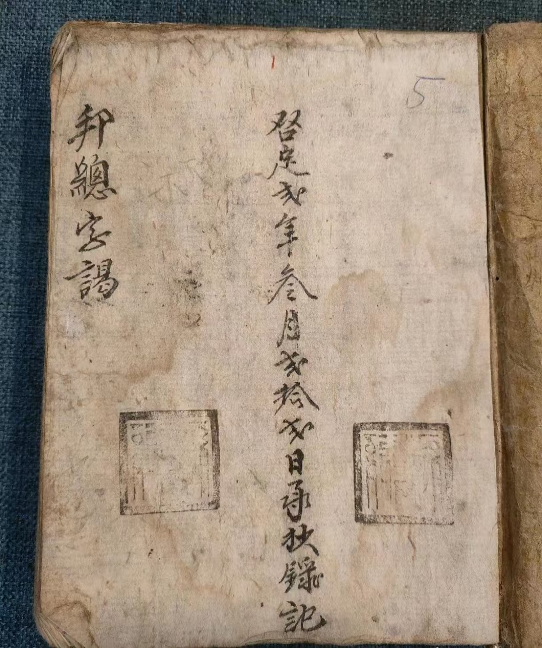
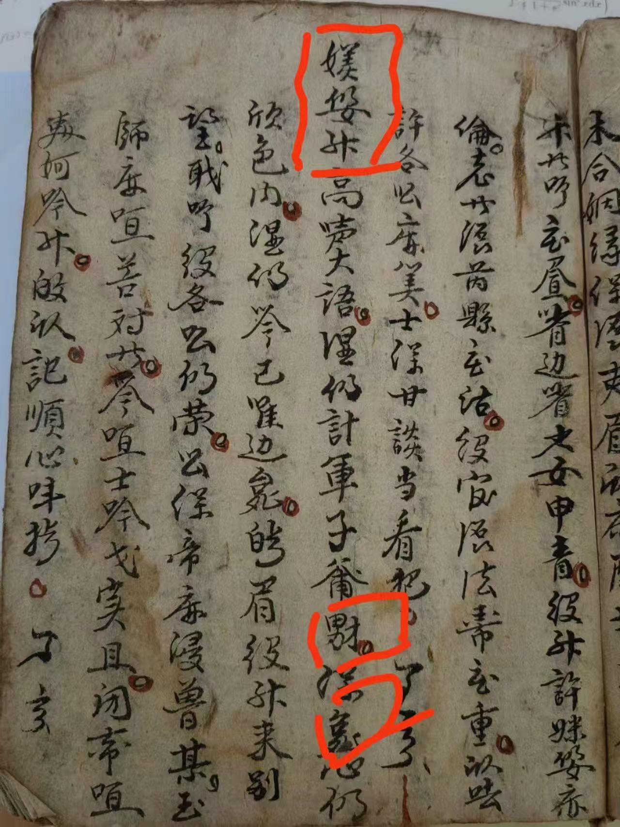
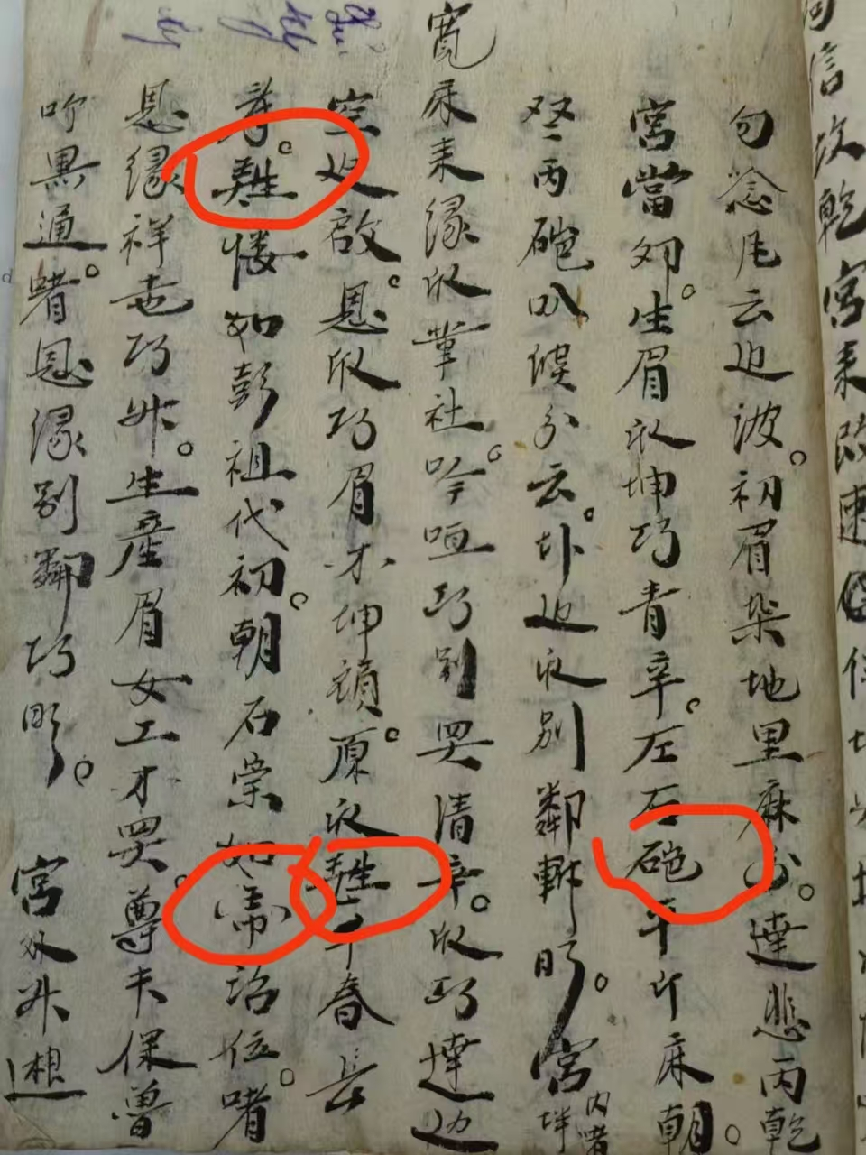
When a manuscript exceeded our framework
Visible, but unreadable.
A border manuscript first mistaken for something else.

Slide 3
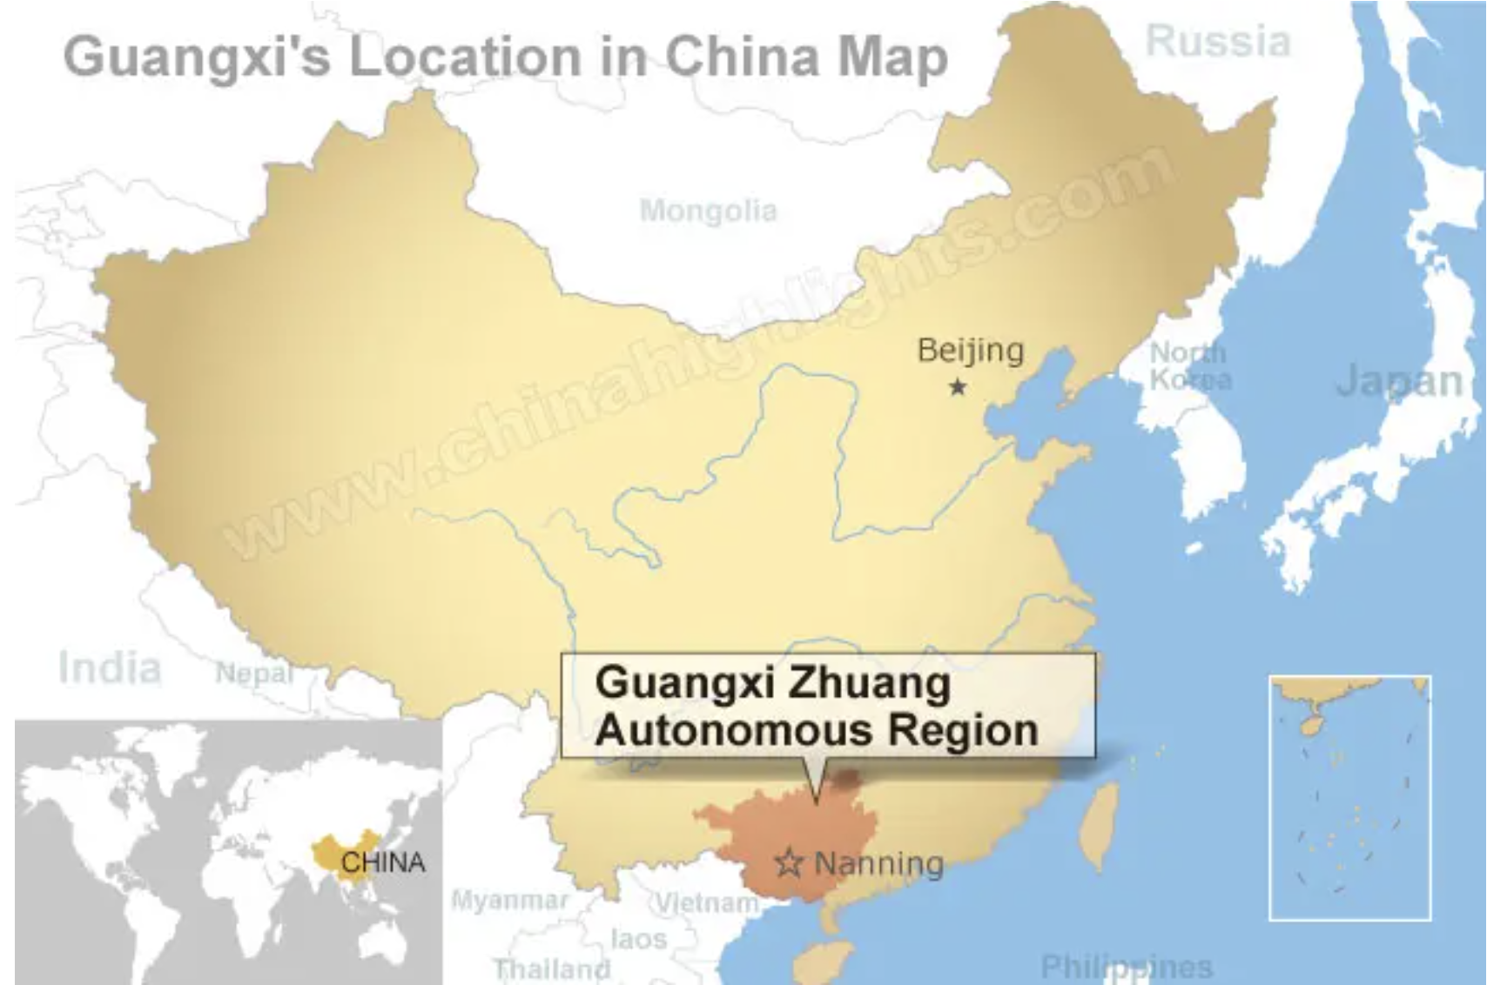
Why Guangxi matters
Related Research Areas
  Guangxi is a border region in Southwest China, adjacent to Vietnam
  It is home to Zhuang ethnic minority and related Tai-speaking communities
  Manuscripts in Guangxi developed through the interaction of Chinese texts, local Zhuang practices, and cross-border connections with Vietnam.
A Map of the Geographical Location of Guangxi

Slide 4
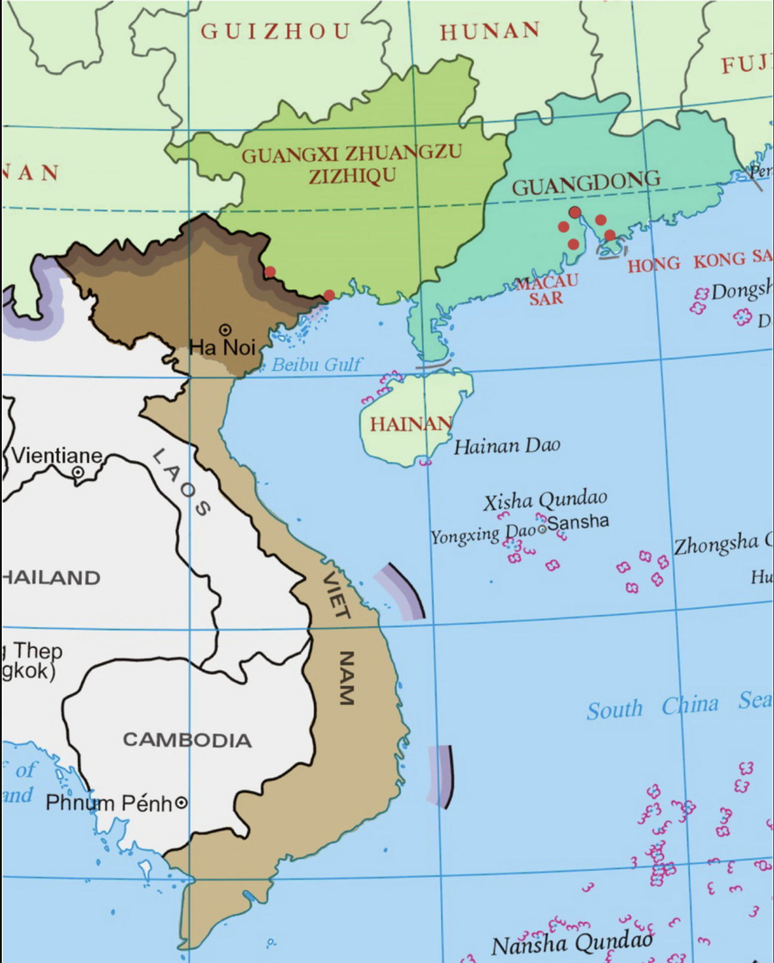
Why Guangxi matters
Related Research Areas
  Guangxi is a border region in Southwest China, adjacent to Vietnam
  It is home to Zhuang ethnic minority and related Tai-speaking communities
  Manuscripts in Guangxi developed through the interaction of Chinese texts, local Zhuang practices, and cross-border connections with Vietnam.
A geographical map of Guangxi and Vietnam

Slide 5
Why did this manuscript become unreadable?
We first approached it through a single Chinese-script framework
We underestimated Guangxi border history and its links to northern Vietnam
We treated variation as irregularity, rather than evidence of a layered writing environment

Slide 6
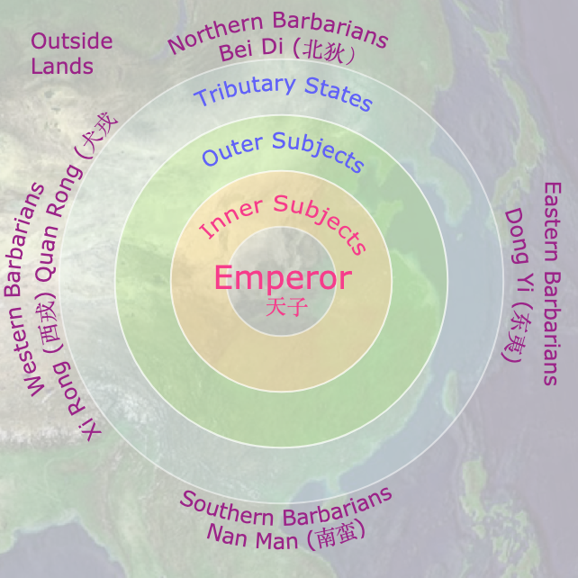
Literature Review
What scholarship explains
  Standardization and central regulation
  Persistence of older forms in minority regions
  Border movement of texts across linguistic and political boundaries
What remains unclear
  Different kinds of variation are often collapsed together
  Persistence and local refunctioning are not the same
  Cross-border clues do not equal proven transmission chains
Image of Tianxia (“all under heaven”) from the Western Zhou dynasty (c. 1046–771 BCE)
Graph Sinocentric world and the Barbaric area.

Slide 7
Not all variation means the same thing
Preservation
  Forms that remain active in local manuscripts after receding from more standardized writing.
Resemanticization
  Forms that are retained, but take on new local, ritual, or semantic functions.
Cross-border clue
  Forms or features that suggest a wider border textual environment, without yet proving a one-way chain of influence.
Not every non-standard form indicates active local reproduction.

Slide 8

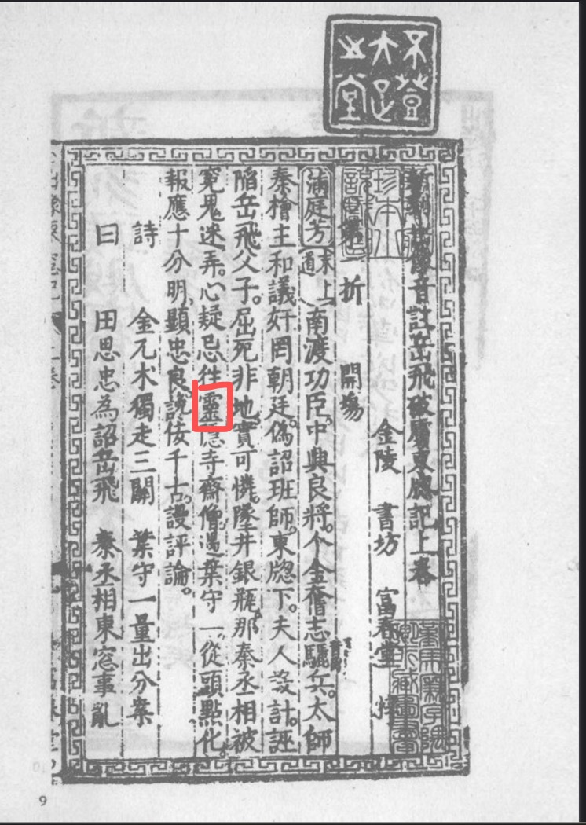
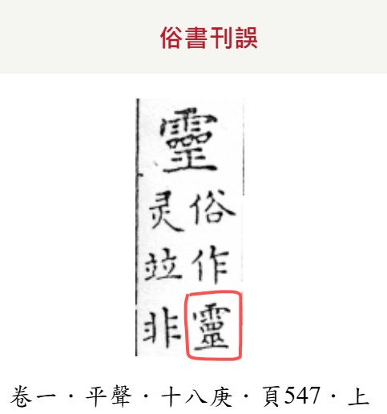
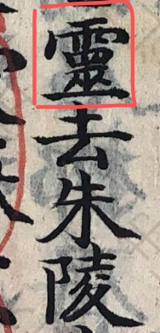
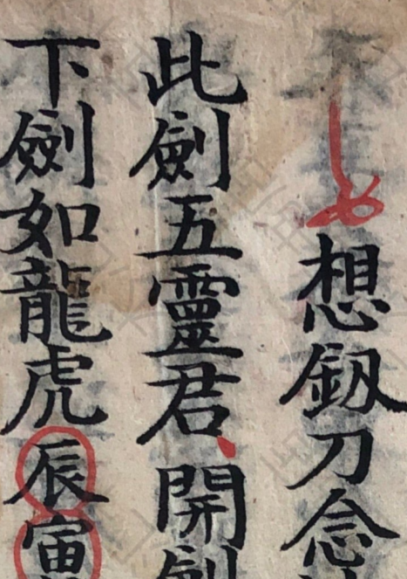


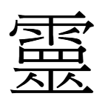

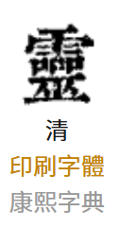
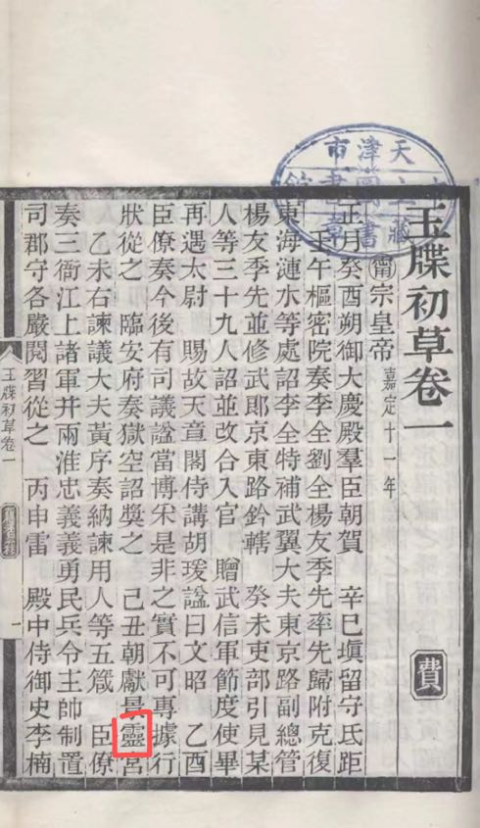
Case 1:Preservation
Some forms remained active in Zhuang manuscripts after receding from more standardized writing
Their continued use reflects a different pace of textual change, not simply error or backwardness
Here, “cultural rhythm” helps describe uneven continuity across textual communities
Ming Dynasty
(1368–1644)
Qing Dynasty
(1644–1912)
Variant Standard
Song Shengmu Xiao'er Shu (Zhuang Manuscript)
Daoguang Period (1821–1850), Qing Dynasty

Slide 9
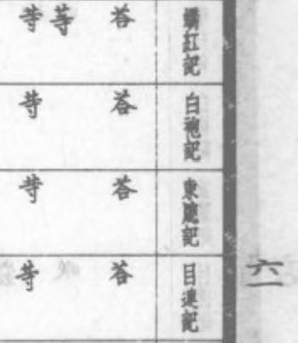
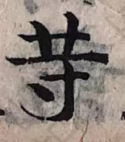


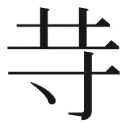

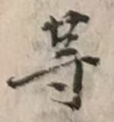
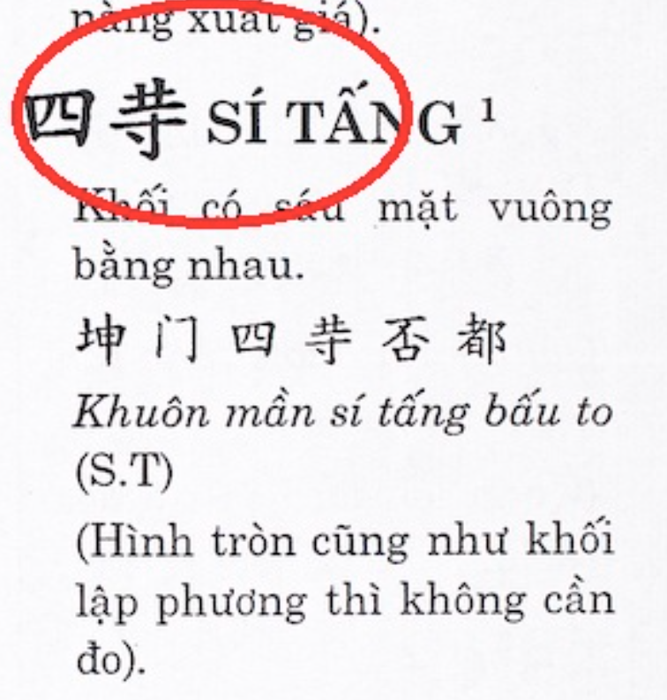
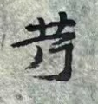
Case 2: Refunctioning
The form remains recognizable, but its function is no longer identical across textual worlds
In Zhuang manuscripts, it enters local ritual and linguistic contexts that reshape its use
Comparable forms in neighboring traditions suggest a shared border environment, but not a simple one-way chain of influence
The same (in degree or quantity); Grade
Ming Dynasty
(1368–1644)
Chinese
Vietnamese
Chu Nom
Variant Standard
in Zhuang
cubic
Step; Many
Mid-to-late Qing Dynasty (1800-1912)

Slide 10
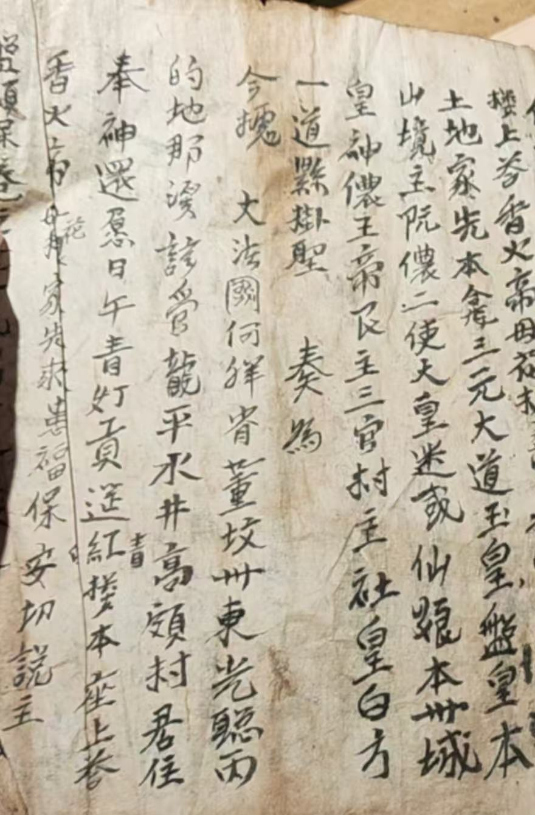
Case 3: Cross-border textual traces
Some manuscripts preserved in Guangxi retain traces tied to northern Vietnam and colonial-era historical contexts
These traces show circulation and preservation across the China–Vietnam border, rather than a closed local archive
Here, “cultural rhythm” helps describe delayed legibility: texts survive across borders, but are not always readable within one framework alone
Title page of a border manuscript dated to the Khải Định era of the Nguyễn dynasty, a period within French colonial Indochina.
Great French Ha Giang (Hà Giang) Province

Slide 11
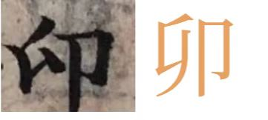
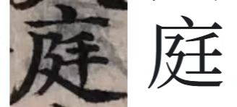
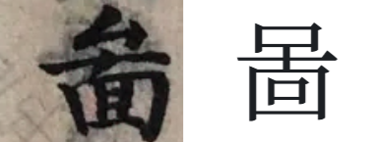
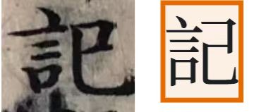
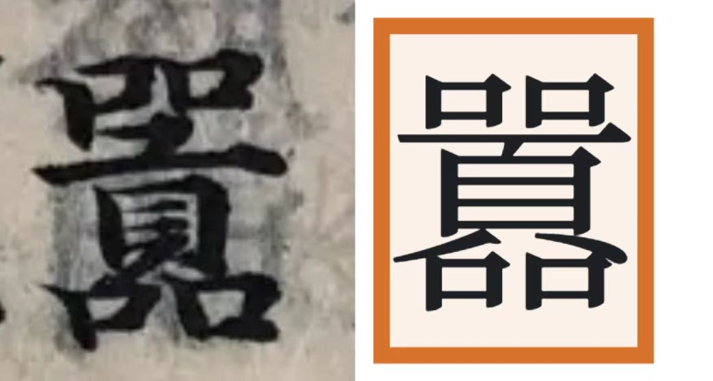
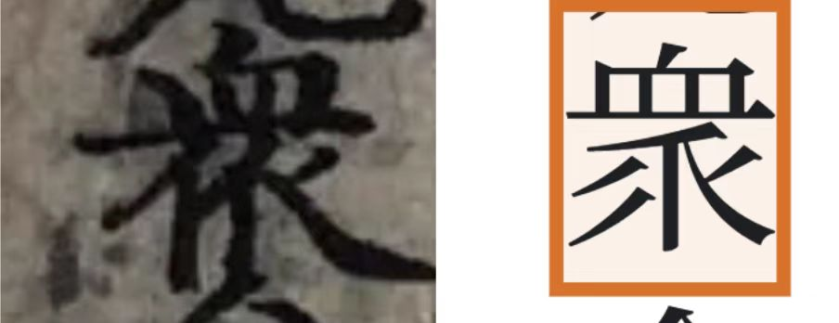
Results
Key Findings: more and more……

Slide 12
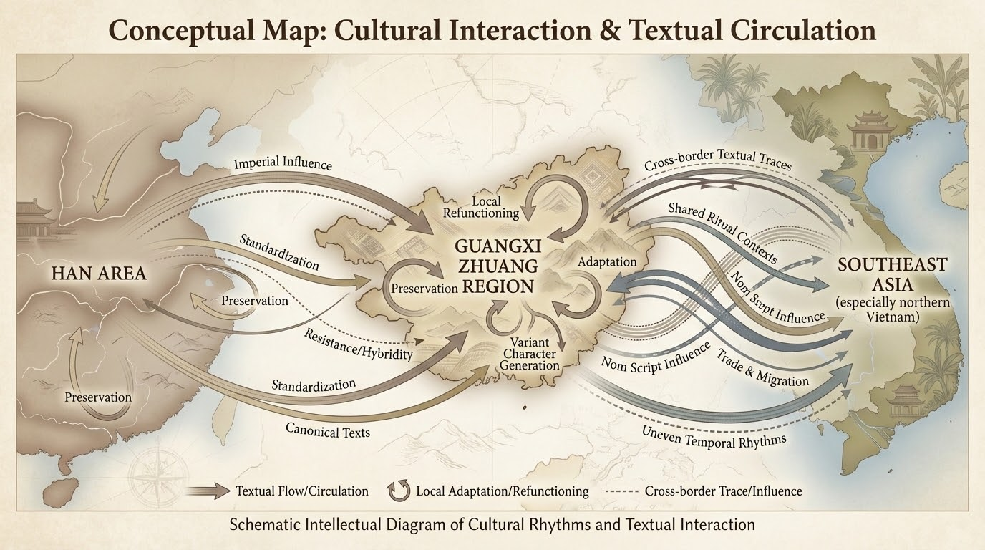
What “cultural rhythm” helps me see
Textual change does not happen at the same pace everywhere
Some forms persist through continuity; others persist by taking on new work
Some texts remain present, but become eligible again only across borders and historical layers

Slide 13
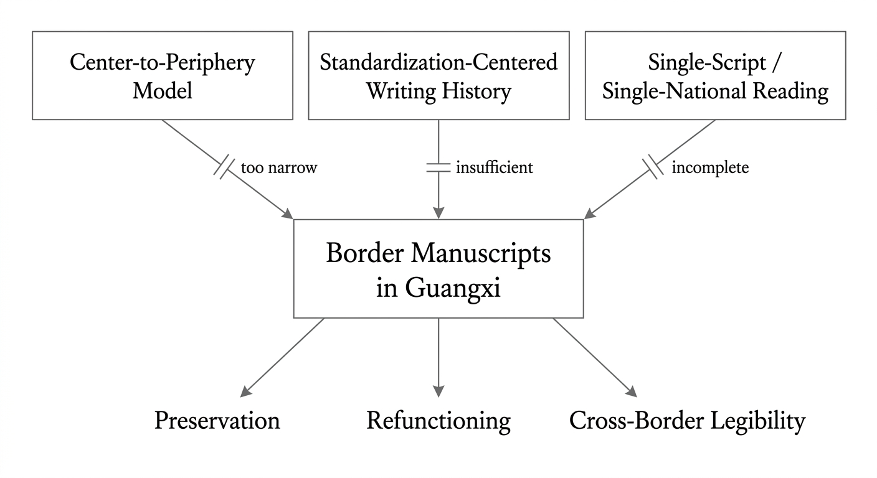
What older frameworks do these cases challenge?
Older framework | Assumption | What my cases suggest
Center → Periphery | Border regions mainly receive or preserve | Border texts also transform, re-layer, and redirect meaning
Standardization-centered history | Non-standard forms are residual or deficient | Some non-standard forms remain active or useful
Single-script / single-national reading | A manuscript belongs to one textual world | Border manuscripts may require multiple frameworks to become legible

Slide 14
Limits and open questions
Limitations of the Study
  “Cultural rhythm” is used here as a provisional analytic, not a total theory.
  These cases are suggestive, not exhaustive.
  Focused primarily on the Zhuang region; further comparative studies with other minority areas (e.g., Miao or Dong regions) could provide broader insights.
  At present, there is a lack of systematic linguistic and historical research on the use of some variant characters and their semantic changes
Future Research Directions
  Interdisciplinary Approaches:
    Incorporate digital humanities techniques, such as computational textual analysis, to uncover broader patterns in the evolution of variant characters.

Slide 15
References
[1]Zhao, T. Y. (2016). Hui Ci Zhongguo: China as a Sacred Concept (p. 18). Citic Press Group.
[2]Tan, Q. X. (Ed.). (1982). Historical Atlas of China. China Cartographic Publishing House.
[3]Same as [2], p. 15.
[4]Ge, Z. G. (2011). Zhai Zi Zhongguo: Reconstructing Historical Narratives about "China" (p. 35). Zhonghua Book Company.
[5]Kong, A. (Annotation), & Lu, D. (Glossary). (Song Dynasty Block-Printed Edition). The Book of Documents (Shangshu). Jing Wucheng Liu's Jia Yetang Collection (Sibu Congkan Edition).
[6]Wu, F. (2014). The Five Zones Map and the Kinship System in Ancient China. Social Sciences in China, 2014(02).
[7]Zhang, Y. S., & Chen, T. J. et al. (Eds.). (1716). Kangxi Dictionary. Qing Dynasty Block-Printed Edition.
[8]Gou, J. S. (Collector). (Daoguang Period, Qing Dynasty). Song Shengmu Xiao'er Shu (Manuscript). Privately held, Chaoyang District, Beijing.
[9]Gou, J. S. (Collector). (Late Qing Dynasty). Lingbao Shengdu Mifa Daquan (Manuscript). Privately held, Chaoyang District, Beijing.
[10]Fuchuntang (Publisher). (Circa Jiajing–Wanli [1522–1620]). Yue Fei's Defeat of the Invaders and the Eastern Window Record. Jinling.

Slide 16
References
[11]Fuchuntang (Publisher). (Circa Jiajing–Wanli [1522–1620]). Xue Rengui’s Expedition to the East and the White Robe Chronicle. Jinling.
[12]Miao, Q. S. (Compiler). (Guangxu–Xuantong Period, Qing Dynasty). Yu Die Chu Cao Juan Yi. In Ouxiang Ling Shi (Guangxu to Xuantong Period, Qing Dynasty Block-Printed Edition). Tianjin Municipal Library Collection.
[13]Jinling Carving Scripture Office (Publisher). (Guangxu 16 [1890]). Buddha’s Forty-Two Chapters Sutra with Commentary. Capital Library Collection.
[14]Gou, J. S. (Collector). (Late Qing Dynasty). Ji Jiu Ke (Manuscript). Privately held, Chaoyang District, Beijing.
[15]Institute of History and Philology, Academia Sinica. (1930). Dictionary of Vulgar Characters from the Song and Yuan Dynasties. Zhonghua Book Company.
[16]Jiao, H. (Wanli Period, Ming Dynasty). Corrections on Vulgar Characters. Ming Dynasty Block-Printed Edition.
[17]Jin, H., et al. (Supervising Editors). (Qing Dynasty). Guangxi Gazetteer. Qing Dynasty Editorial Edition.
[18]Yang, X. Y., Liang, J. H., & Zhao, C. X. (1997). History of Guangxi Education. Guangxi Normal University Press.

Slide 17
References
[19]Lan, W., & Huang, D. C. (2019). The Historical Periodization, Characteristics, and Multi-dimensional Causes of Guangxi Academies in the Ming Dynasty. Heilongjiang Social Sciences, 2019(2), 136–143.
[20]Gou, J. S. (Collector). (Guangxu Period, Qing Dynasty). Qiu Lu Lang (Manuscript). Privately held, Chaoyang District, Beijing.
[21]Hoàng, T. Â. (2003). Tự điển chữ Nôm Tày. Hà Nội: Nxb Khoa học Xã hội.
[22]Nguyễn, Q. H. (2014). Tự Điển Chữ Nôm Dẫn Giải. Hà Nội: Nhà Xuất Bản Giáo Dục Việt Nam.
[23]Nguyễn, D. (1820). Truyện Kiều (金云翘传).
[24]Anonymous. (Early 19th century). Phan Trần (潘陈传).

Slide 18


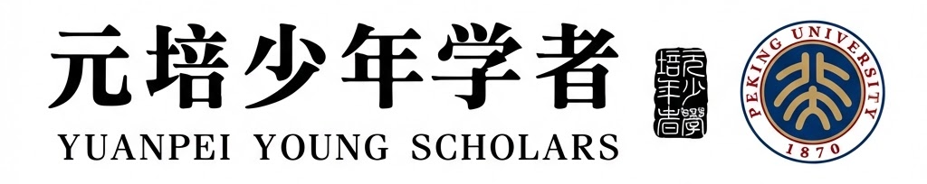

Thank you for all criticism and guidance.
Boge Xiao
xiaoboge1109@gmail.com

